Slide 1
SEARCH – a New Slow Start Algorithm for TCP and QUIC
UPDATE
Jae Chung
Feng Li
Maryam Ataei Kachooei
Mark Claypool
IETF CCWG
Dublin, Ireland
November 2024

Slide 2
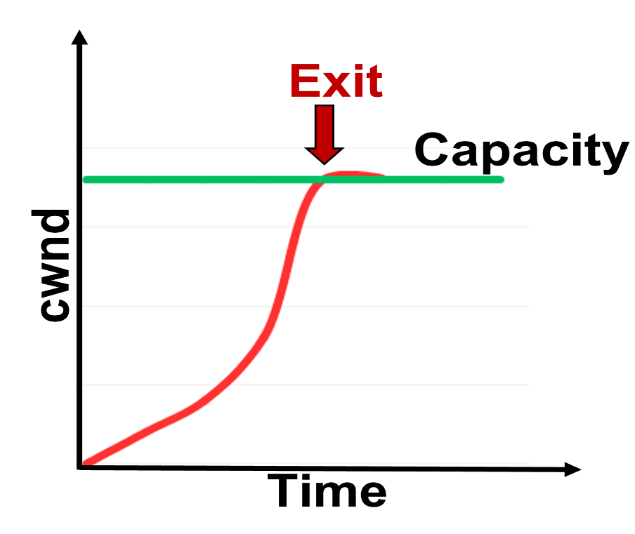
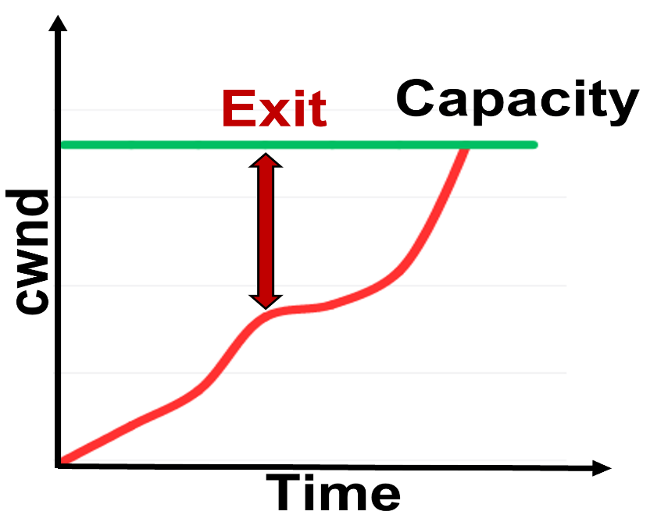
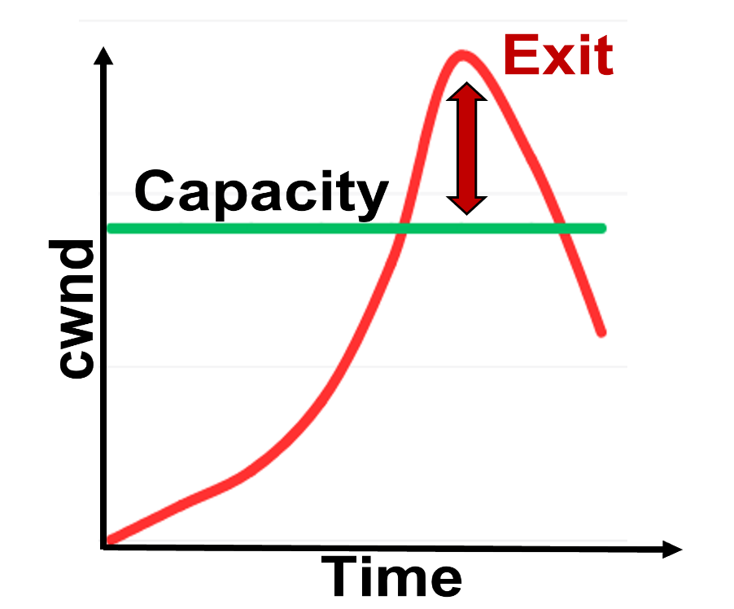
Motivation
Exit Too Early
Exit Too Late
Exit at Choke Point
HyStart over wireless
SEARCH

Slide 3
SEARCH – Slow start Exit at Right CHokepoint
8a
8a
sent bytes
delivered bytes
4a
capacity
4a
capacity
2a
2a
a
a
t₁
t₂
t₃
t₄
t₅
t₁
t₂
t₃
t₄
Time
Time

Slide 4
SEARCH – Slow start Exit at Right CHokepoint
sent’ = 2 ∙ delv _{previous}
diff = sent’ – delv _{now}
normalized_diff = diff / sent’
normalized_diff $≥$ threshold?
→ exit slow start
8a
delivered bytes
4a
capacity
2a
a
t₁
t₂
t₃
t₄
t₅
Time

Slide 5
Outline
SEARCH Review (done)
Updates (next)
Algorithm
Reduce Bytes per Flow
Test Rate Limited Flows
Next Steps

Slide 6
Algorithm Update
0
1
2
3
4
5
0
1
2
3
4
5
10
20
10
20
30
20
10
30
40
60
90
110
bins are bytes received during that interval
bins are cumulative bytes received up to that interval
Bytes delivered from bin 1 to bin 4?
4
∑ bin [i] = bin[1] + bin[2] + bin[3] + bin[4]
bin[4] - bin[0]
1

Slide 7
Suggested Updates from Last IETF Meeting
Per-flow memory use
Rate-limited flows

Slide 8
Reduce Bytes Per Flow
SEARCH-specific per-flow data
u32 bin[TOTAL_BINS]; // array of bins
u32 bin_duration_us; // duration of each bin
u32 bin_end_us; // end time of latest bin
s32 curr_idx; // total number of bins
Reduce number of bits for each bin
u8 scale_factor; // divisions by 2 (shifts)
u32 → u8
bytes
ACKed
0
1
2
3
4
5
6
?
scale factor
10
30
40
50
80
120
280
1
5
15
20
25
40
60
140
140

Slide 9
Error with Reduced Bits Per Bin
sent’ = 2 ∙ delv _{previous}
diff = sent’ – delv _{now}
normalized_diff = diff / sent’
normalized_diff $≥$ threshold?
→ exit slow start
u32 bin[TOTAL_BINS]; normalized_diff
?
u8 bin[TOTAL_BINS]; normalized_diff

Slide 10
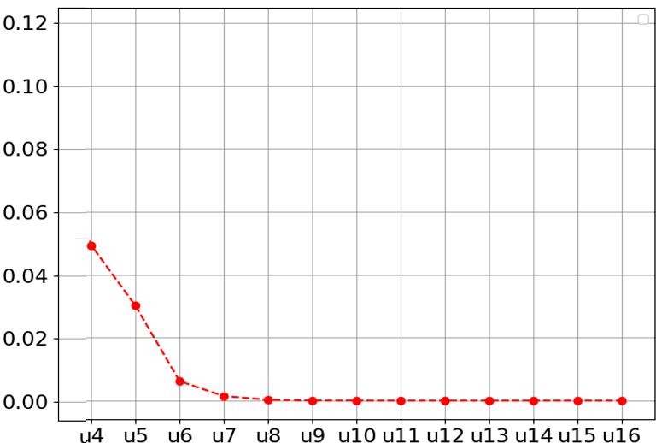
Error with Reduced Bits Per Bin
u32 bin[TOTAL_BINS];
normalized_diff
?
Normalzied Diff MSE
normalized_diff
u8 bin[TOTAL_BINS];
bin size (in bits)

Slide 11
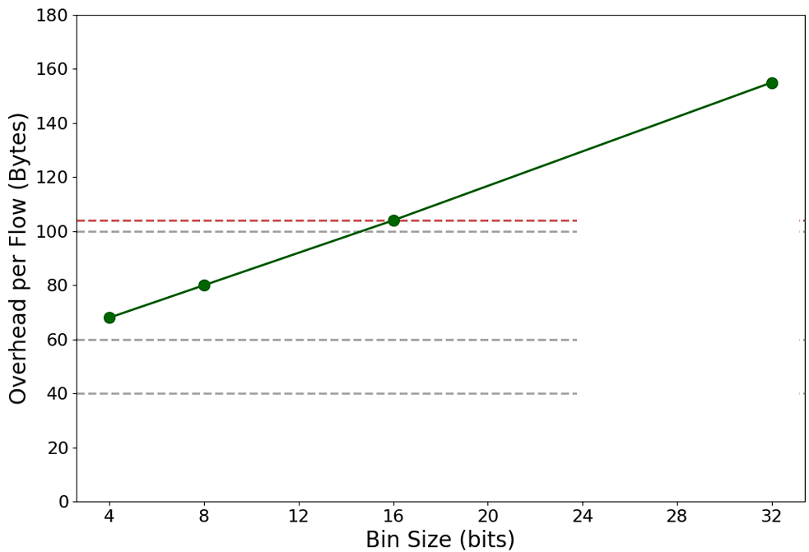
Per-Flow Memory
BBR
Linux
Private
ICSK_CA_PRIV
104 bytes
Cubic + HyStart
Cubic

Slide 12
Per-Flow Memory
Cubic
Cubic + HyStart
Cubic + SEARCH (u8)
BBR
Cubic + SEARCH (u16)
Cubic + SEARCH (u32)

Slide 13
Suggested Updates from Last IETF Meeting
Per-flow memory use
Rate-limited flows

Slide 14
Test Rate Limited Flows
Application limited TCP flow
Periodic – e.g., HTTP streaming
Intermittent – e.g., Web browsing
Application rate limited – e.g., CBR traffic
Receiver / Sender limited TCP flow
e.g., buffer size limits

Slide 15
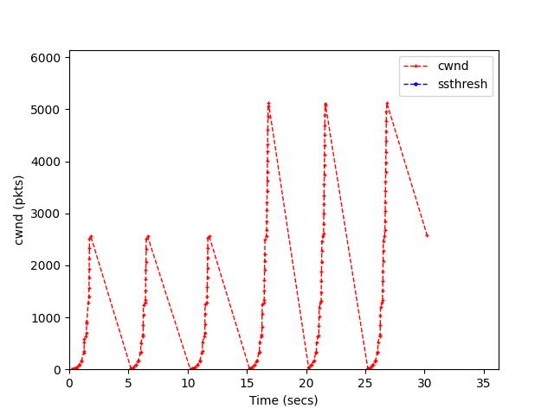
Test Rate Limited Flow – Application
AWS EC2 Linux
netem to add 200 ms latency
Application limited flow (e.g., HTTP server)
3x 32 MB chunks at 5 s intervals
3x 64 MB chunks at 5 s interval

Slide 16
Outline
SEARCH Review (done)
Updates (done)
Algorithm (done)
Bytes per Flow (done)
Rate Limited Flows (done)
Next Steps (next)

Slide 17
Next Steps
CCWG seeks empirical evidence of safety
Most impactful → data from deployments in the field
Looking for volunteers!
We will help with SEARCH deployment
Provide implementation (currently, Linux and Quicly, working on FreeBSD version)
Help with installation and trouble shooting
Give assistance with data collection and analysis
claypool@wpi.edu

Slide 18
Summary
https://search-ss.wpi.edu/
SEARCH
Determines “choke point” from expected delivered bytes
Exits slow start after congestion point, before loss
Updates (now version 3.0)
Algorithm tweak (cumulative bytes)
Reduced bytes per flow
App-limited flows
Looking for volunteers to try it out!
claypool@wpi.edu

Slide 19
SEARCH – a New Slow Start Algorithm for TCP and QUIC
Thank-you for your attention!
Jae Chung
Feng Li
Maryam Ataei Kachooei
Mark Claypool
IETF CCWG
Dublin, Ireland
November 2024

Slide 20
References
Improving TCP Slow Start Performance in Wireless Networks with SEARCH
IEEE World of Wireless, Mobile and Multimedia Networks (WoWMoM)
Perth, Australia, June 2024
Improving QUIC Slow Start Behavior in Wireless Networks with SEARCH
IEEE Local and Metropolitan Area Networks (LANMAN)
Boston, Massachusetts, USA, July 2024
Implementation of the SEARCH Slow Start Algorithm in the Linux Kernel
0x18 NetDev Conference
Santa Clara, California, USA, July 2024

