Slide 1


SEARCH – Better Slow Start for TCP and QUIC
Update
Jae Chung
Feng Li
Maryam Ataei Kachooei
Mark Claypool
IETF CCWG
Montral, Canada
November 2025

Slide 2
TCP Slow Start
Packet loss
Congestion Avoidance
Slow Start
Exponential growth in congestion window
Packet loss Exit slow start: Too late (After loss)
Idea: Exit after reaching capacity and before loss
HyStart (Linux default)
HyStart over wireless Too early (Before capacity)
Congestion Window
Capacity
Time
Goal: At chokepoint: after capacity, before loss

Slide 3
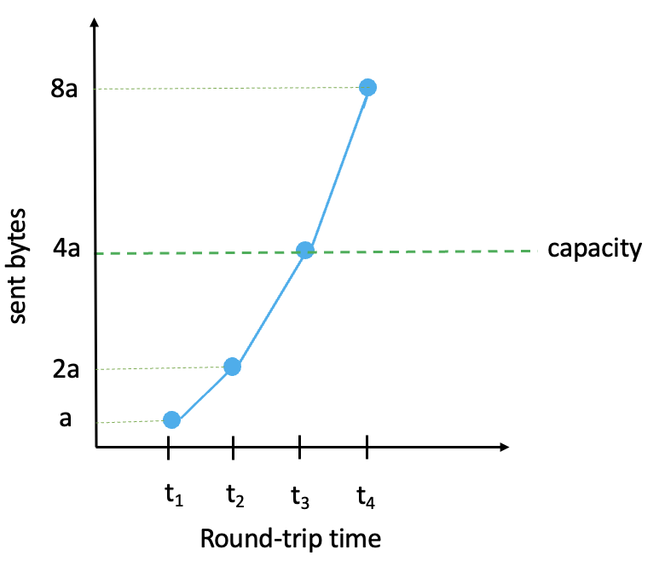
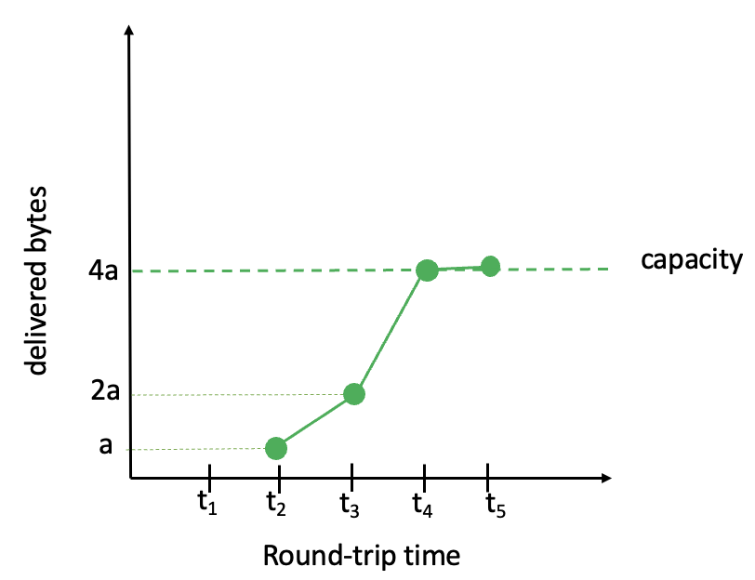
SEARCH Concept
threshold
difference
0
t₁
t₂
t₃
t₄
t₅
Round-trip time

Slide 4
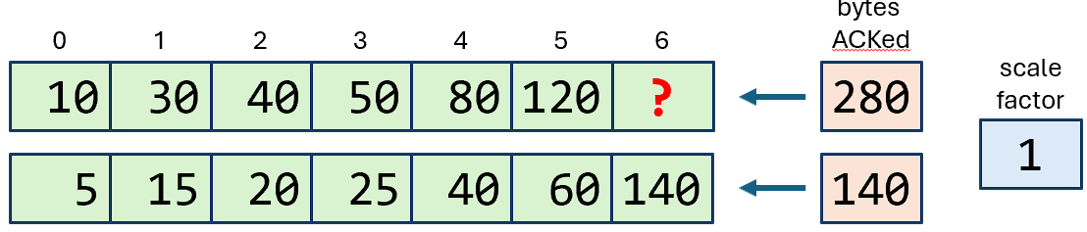
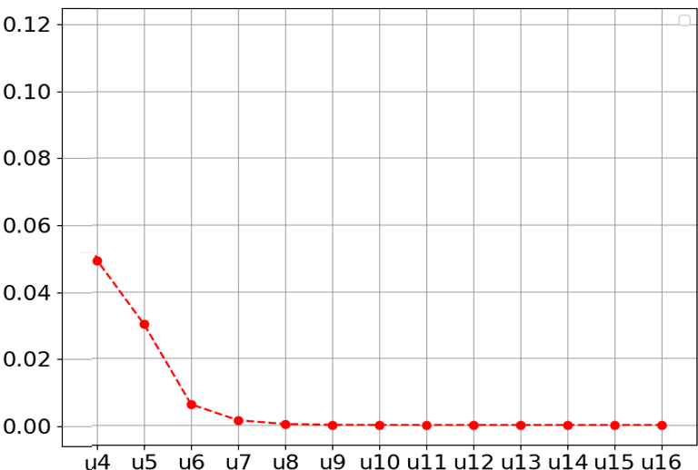
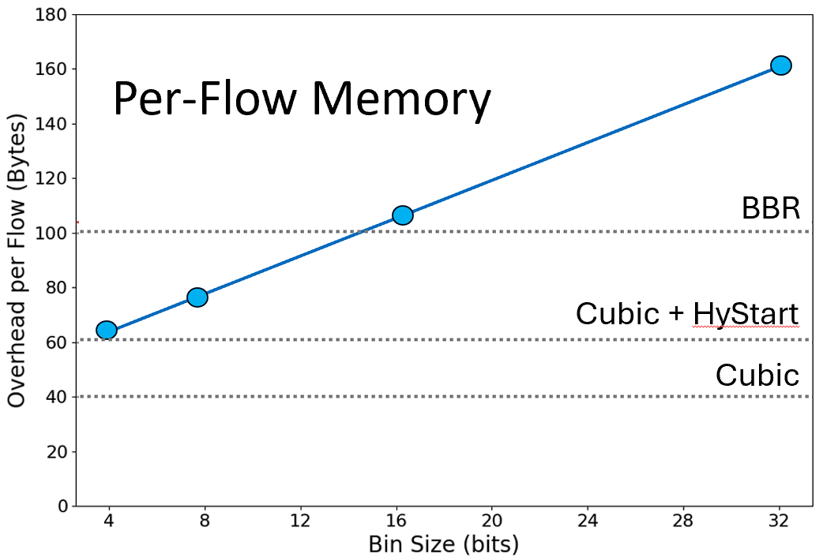
SEARCH Reduced Per-flow Memory
Normalzied Diff MSE
bin size (in bits)

Slide 5
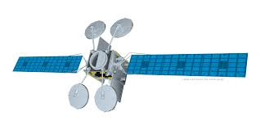
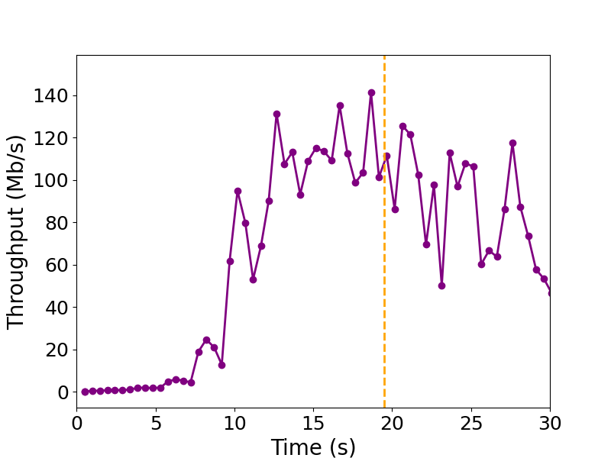
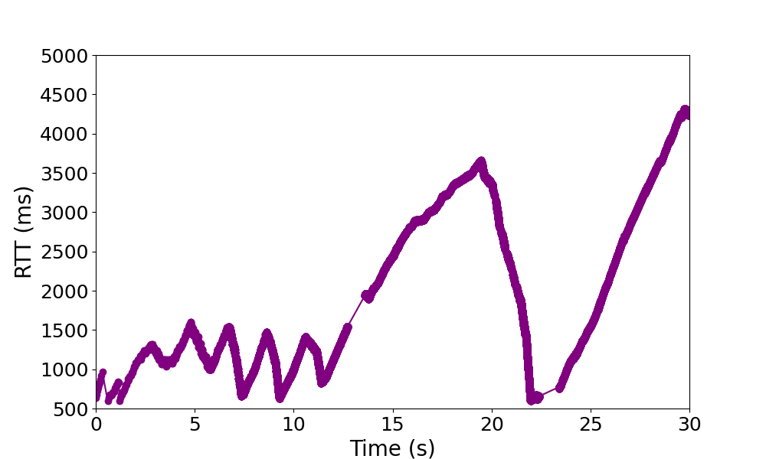
TCP Cubic (without HyStart)

Slide 6
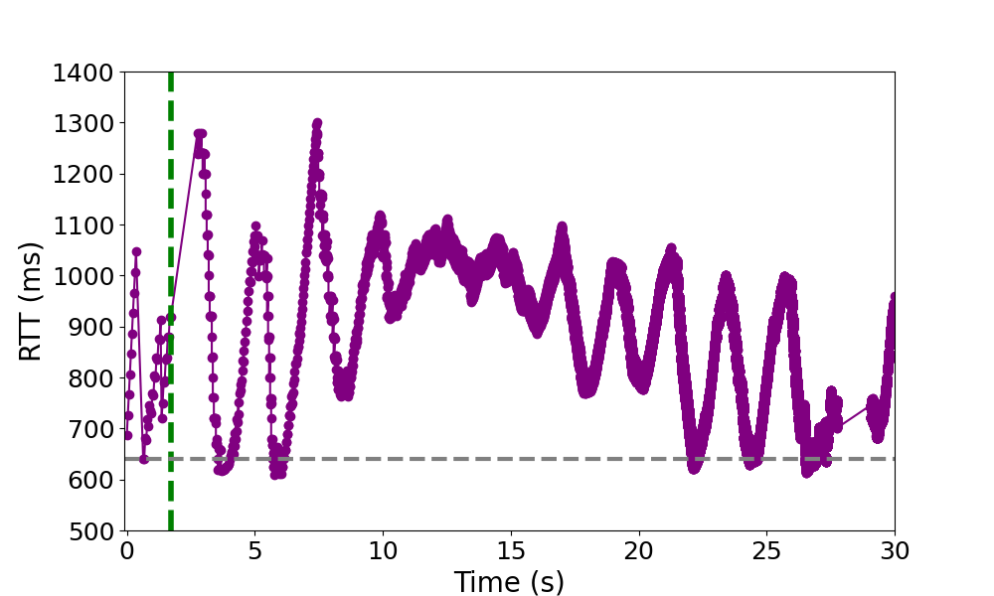
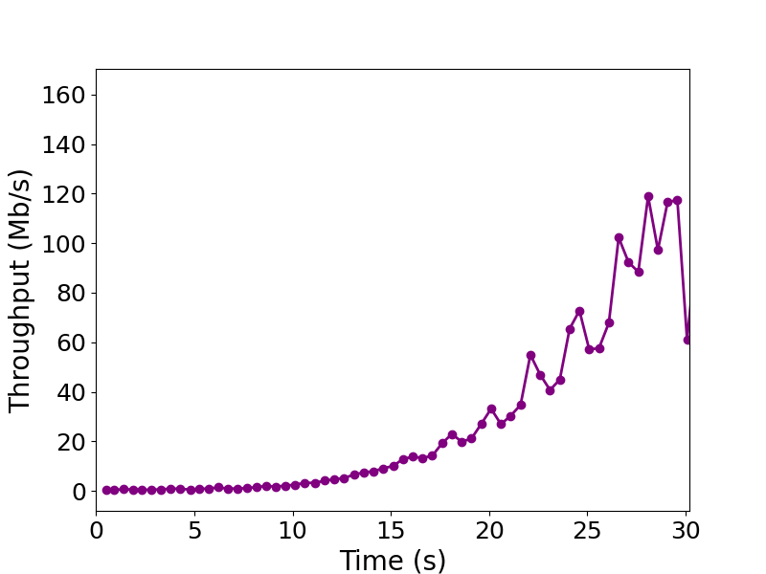
Delay-Based: HyStart, HyStart++
RTT “spikes” → exit SS
Sensitive to RTT variation → early exit, under utilization
  Bad in high BDP networks

Slide 7
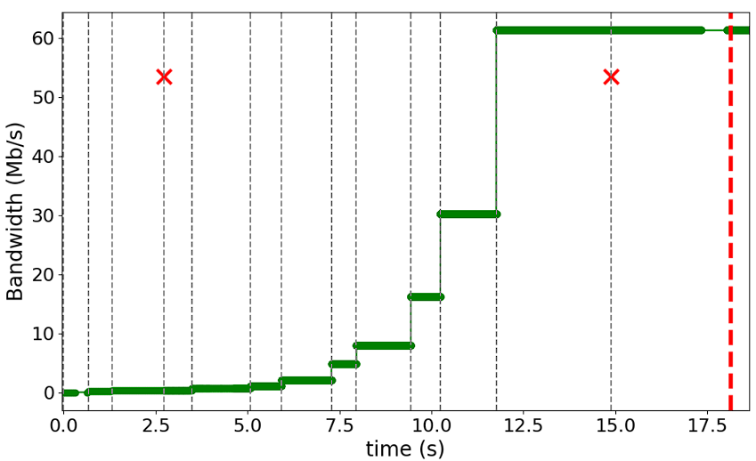
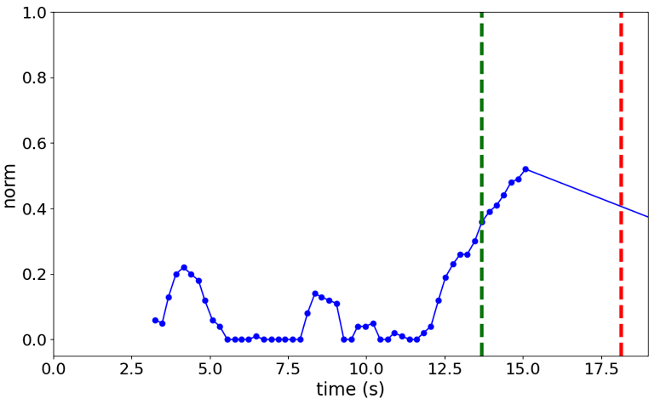
Delivered Bytes-Based: BBR, SEARCH
BBR: Uses current RTT, responds slowly after capacity
SEARCH: Uses initial RTT → resilient to post-capacity delay

Slide 8

Update
Empirical evidence of safety and intent to deploy
Compare SEARCH to HyStart++

Slide 9



Linux – HyStart++
Zimraan Ahmad
Joshua Solomon
Clive Thompson
Balasubramanian, P., Huang, Y., and M. Olson, "HyStart++: Modified Slow Start for TCP", IETF RFC 9406, DOI 10.17487/RFC9406, May 2023
https://www.rfc-editor.org/info/rfc9406.
M. Arghavani, H. Zhang, D. Eyers, and A. Arghavani, “SUSS: Improving TCP Performance by Speeding Up Slow-Start,” in Proceedings of the ACM SIGCOMM Conference, Sydney, Australia, 2024 https://dl.acm.org/doi/abs/10.1145/3651890.3672234
M. Arghavani, "HyStartPP" [Source Code]. Accessed: November 2, 2025 https://github.com/SUSSdeveloper/HyStartPP
HyStartPP

Slide 10
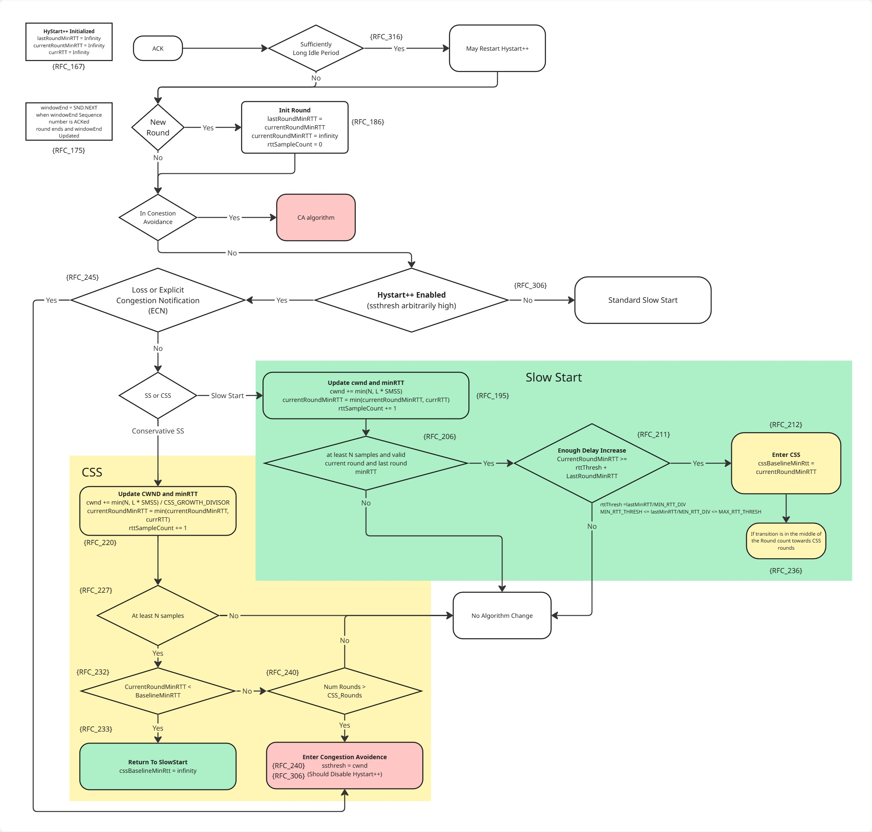
Linux – HyStart++
Zimraan Ahmad
Joshua Solomon
Clive Thompson
HyStartPP
Verification:
HyStartPP coded properly?

Slide 11
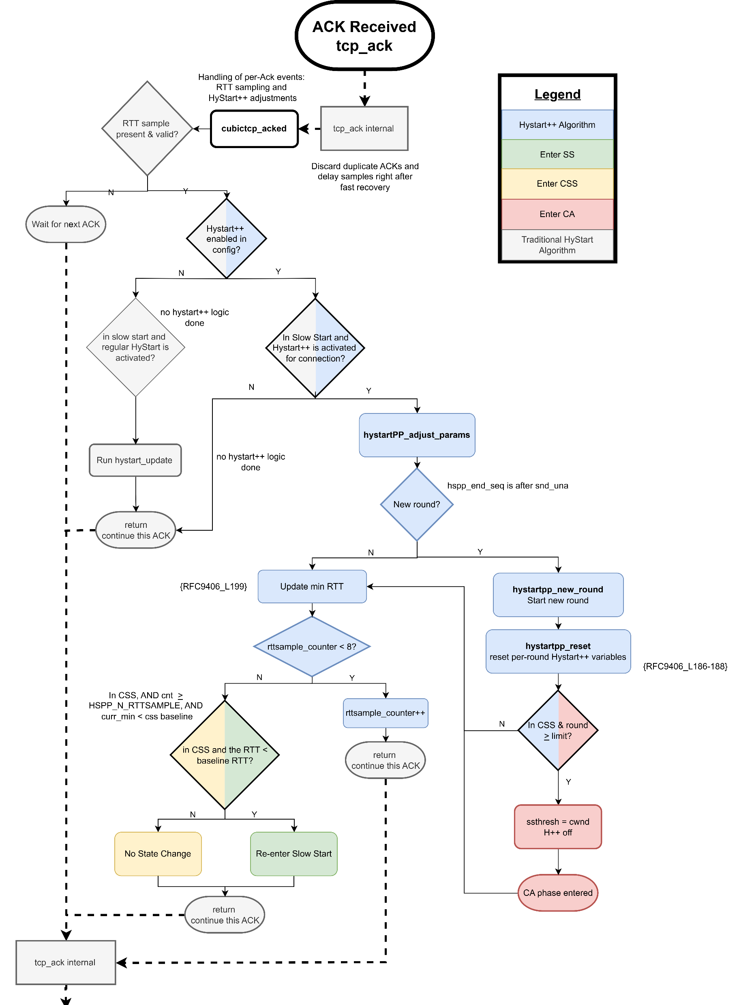
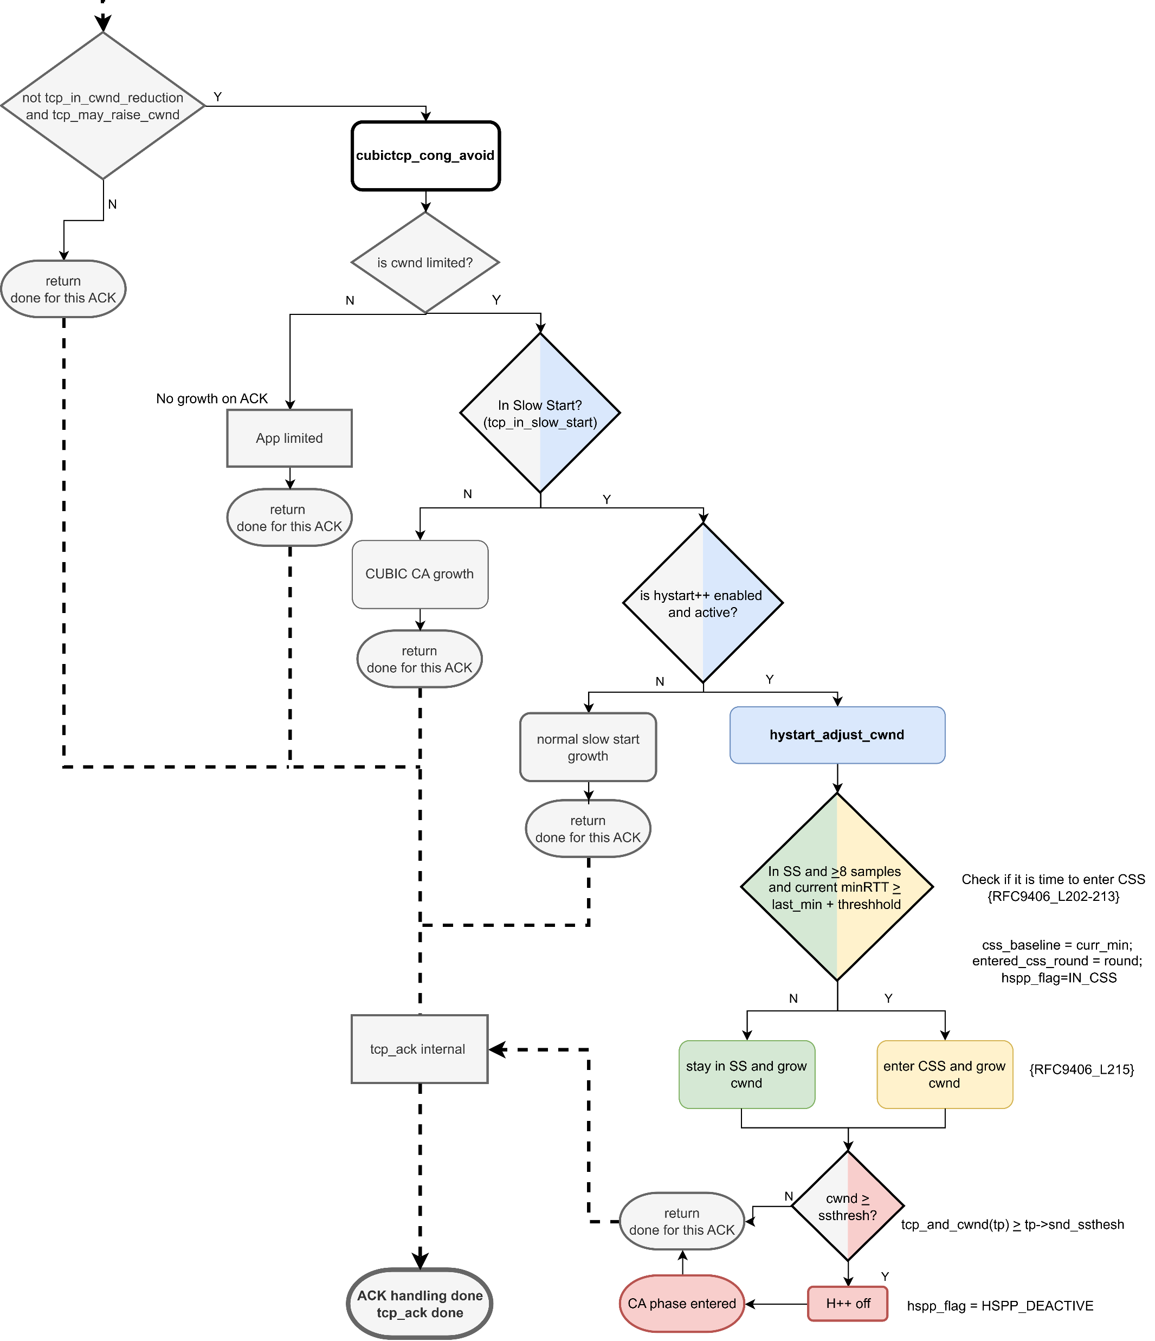
Linux – HyStart++
Zimraan Ahmad
Joshua Solomon
Clive Thompson
Verification:
HyStartPP coded properly?
HyStartPP

Slide 12
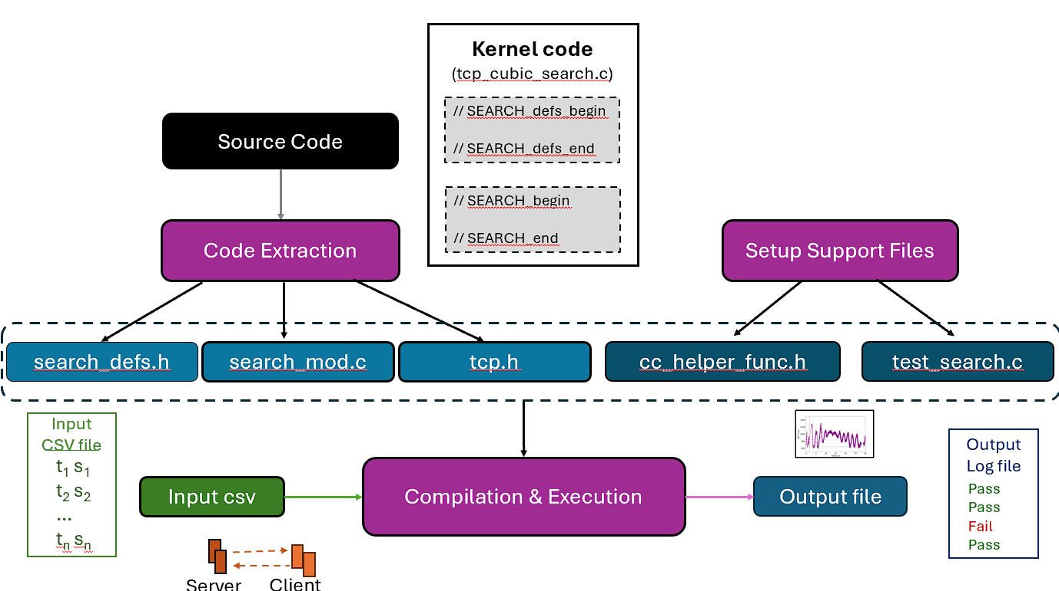
Linux – HyStart++: Verification
Verification:
HyStart++ coded properly?
SS goes to CSS, CSS goes to CA
SS goes to CSS, CSS goes back to SS
Validation:
HyStart++ compared to SEARCH

Slide 13







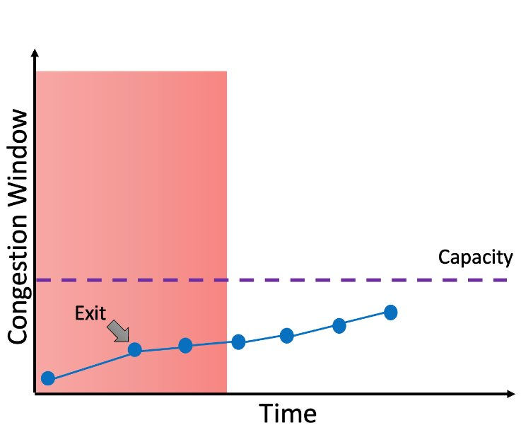
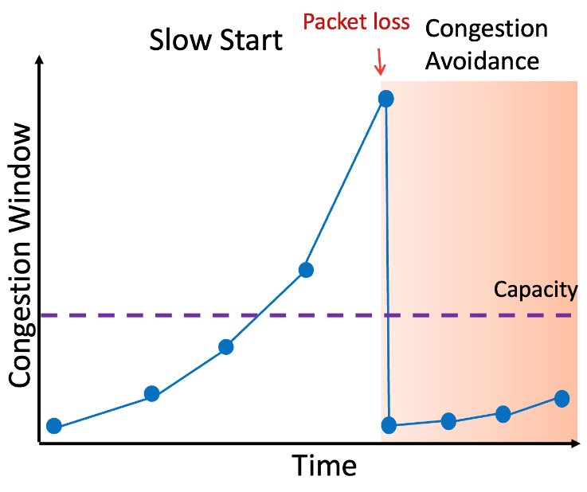


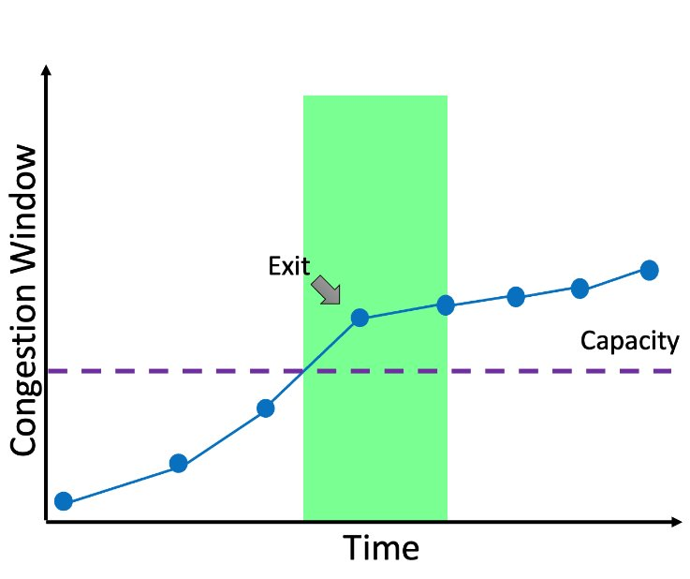
Empirical Evidence of Safety &
Intent to Deploy
Evaluate SEARCH in a production environment
Measure delay for streaming video commencement
Many cases – no difference, but tail of performance distribution

Slide 14
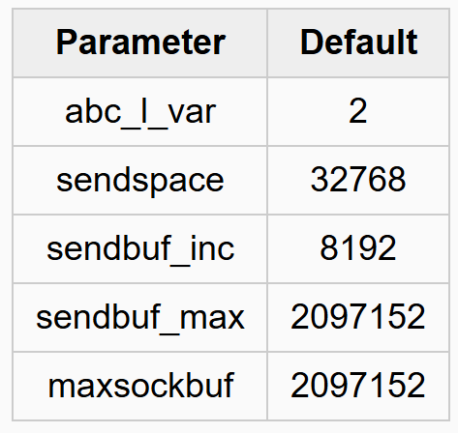
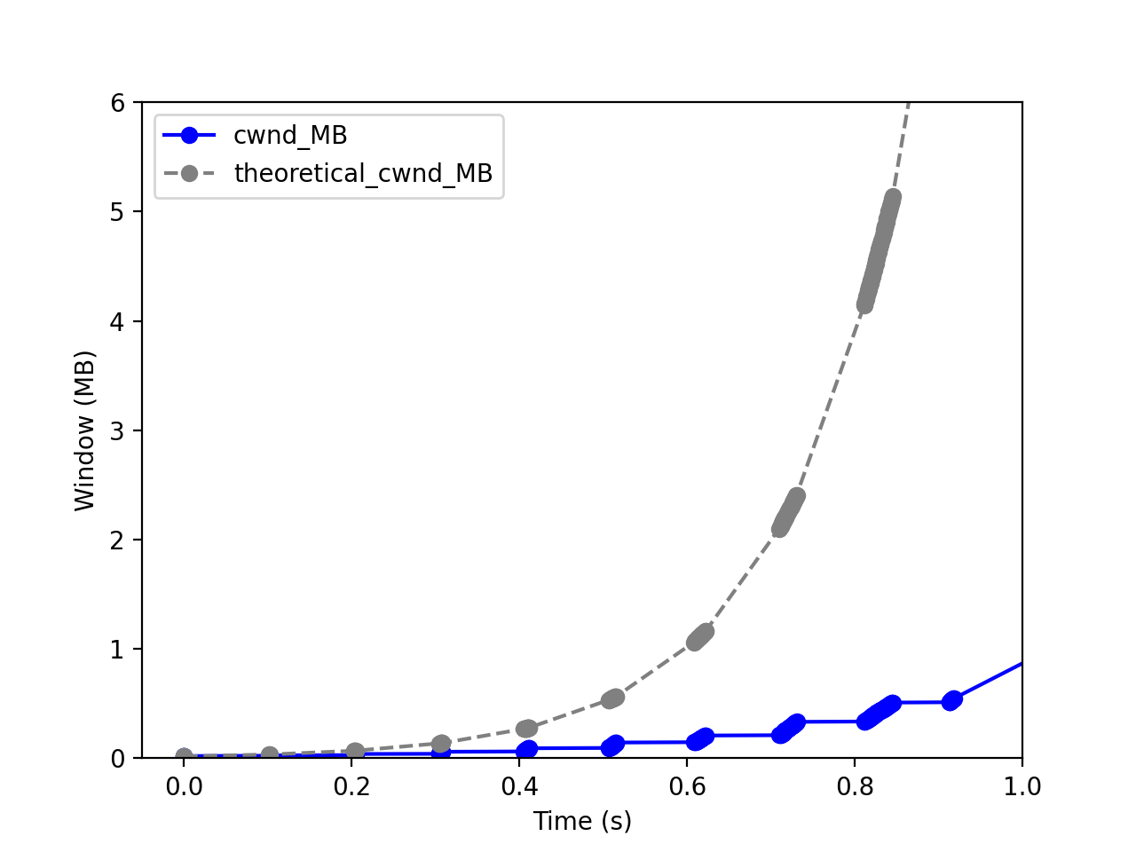
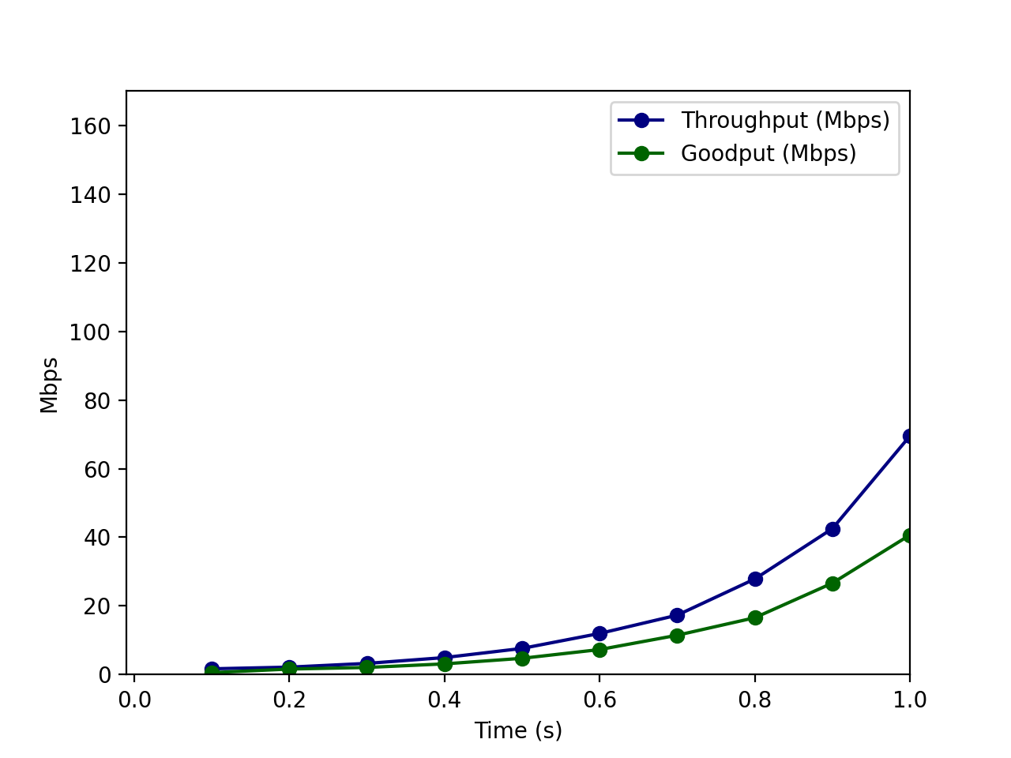
FreeBSD – Default
Rate: 80 Mb/s | Delay: 100 ms | Queue: 5x BDP

Slide 15
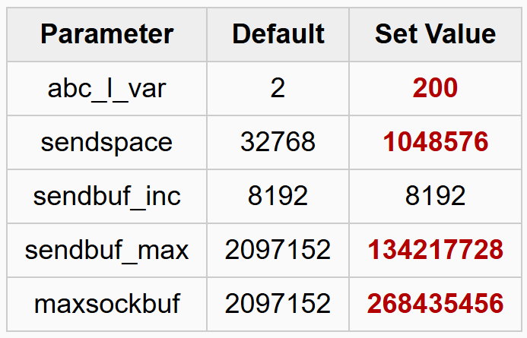
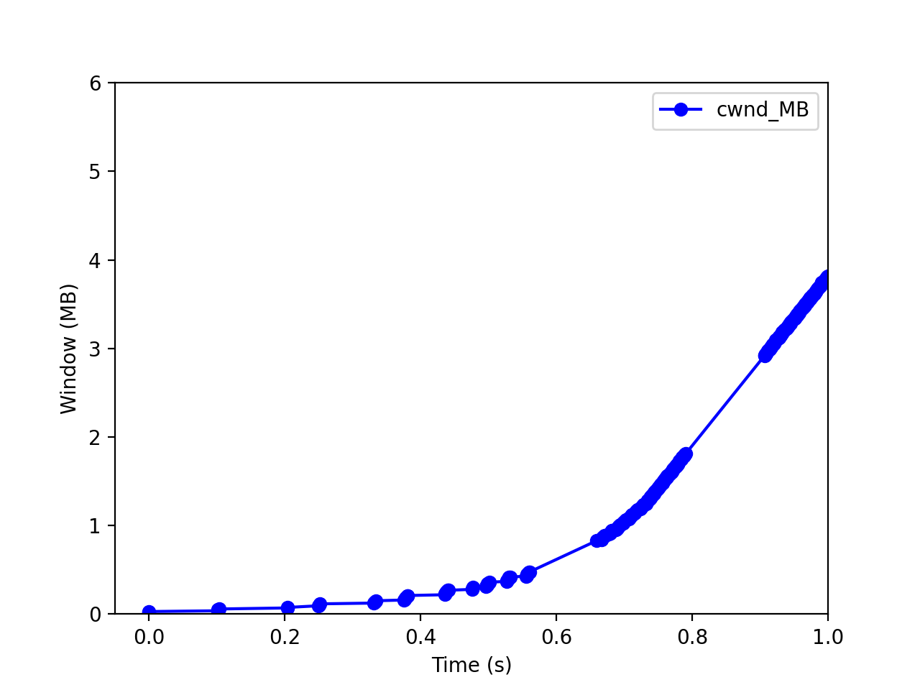
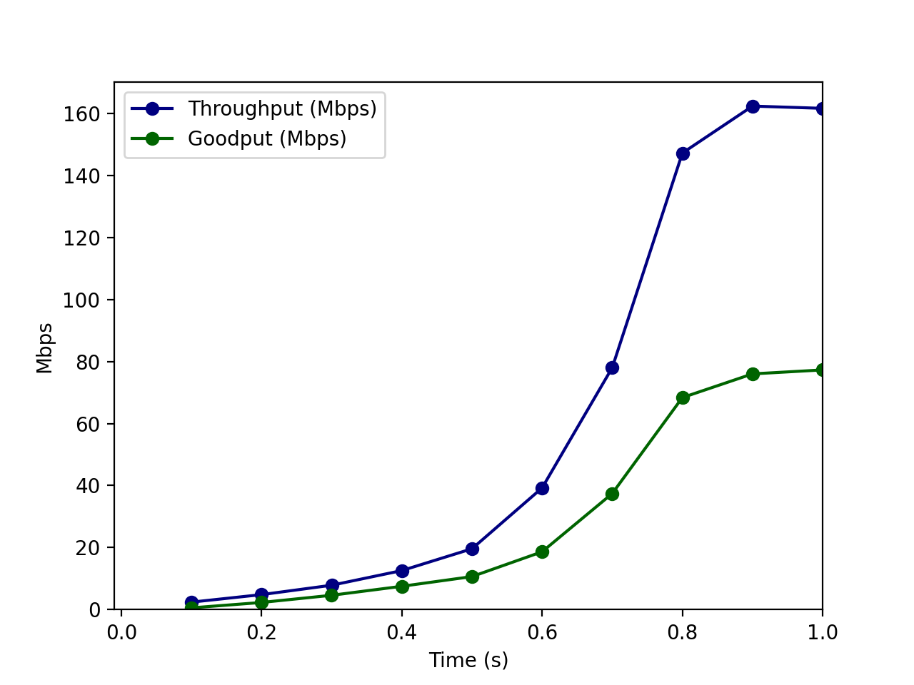
FreeBSD – Tuned, RACK
Rate: 80 Mb/s | Delay: 100 ms | Queue: 5x BDP

Slide 16
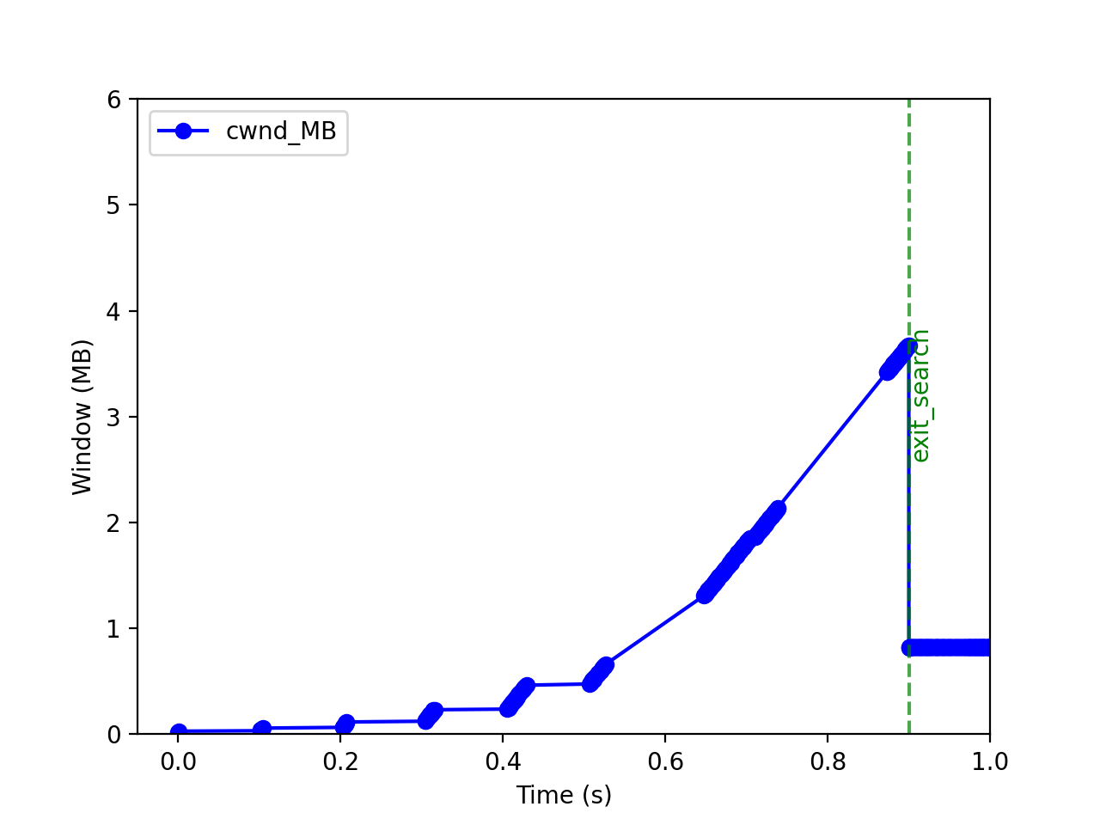
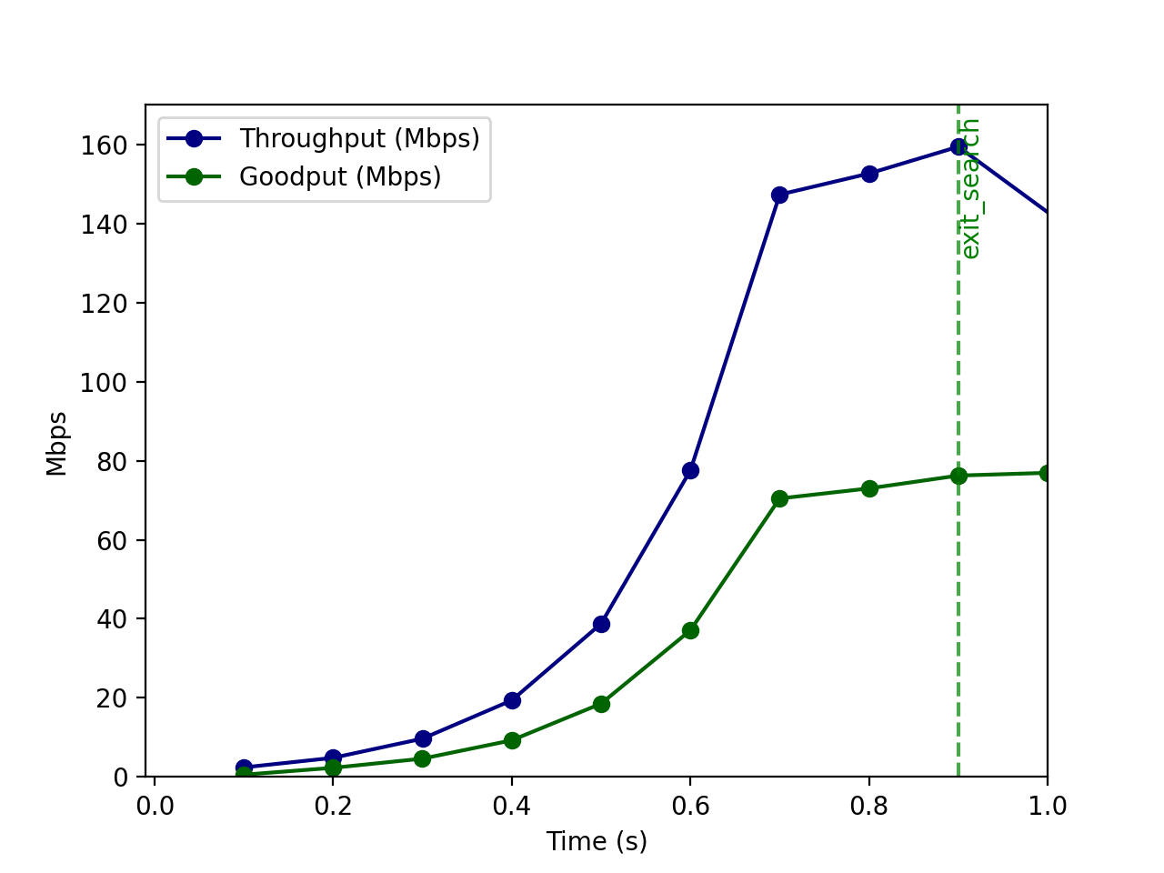
FreeBSD – Tuned, RACK – SEARCH
Rate: 80 Mb/s | Delay: 100 ms | Queue: 5x BDP

Slide 17
Next Steps
Output
Log file
Verify and validate Linux HyStart++ implementation
Broad-based performance eval
  Compare: Traditional, HyStart++, SEARCH
  Normal, edge cases
  WiFi, 4g/5g, GEO, LEO, Wired
Evidence of safety, intent to deploy
  Streaming video
Pass
Pass
Fail
Pass

Slide 18
SEARCH – Better Slow Start for TCP and QUIC
Thank-you for your attention!
Update
Jae Chung
Feng Li
Maryam Ataei Kachooei
Mark Claypool

Slide 19
Extra Slides

Slide 20
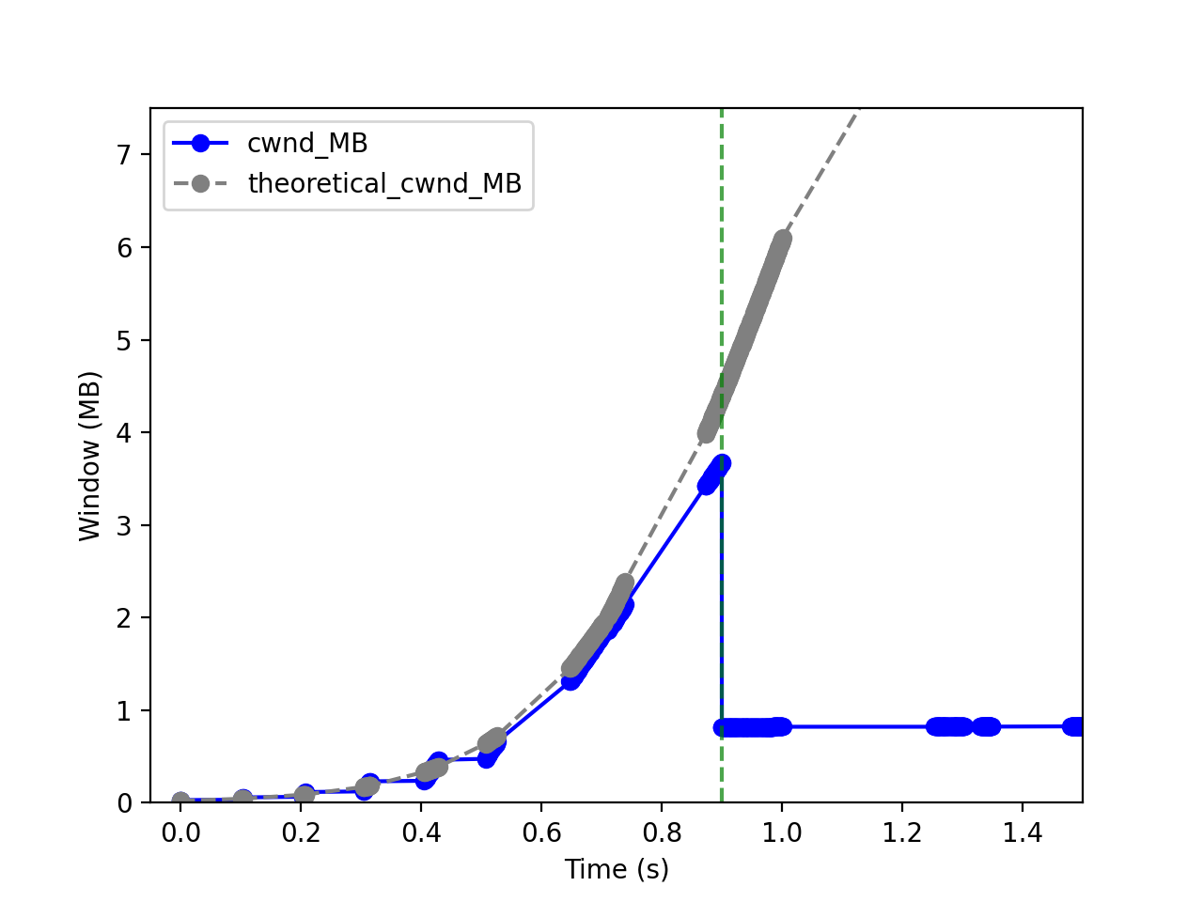
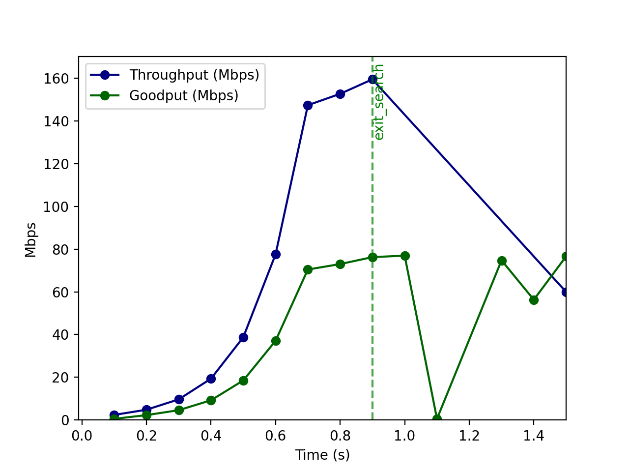
Free BSD – Tuned – SEARCH

Slide 21
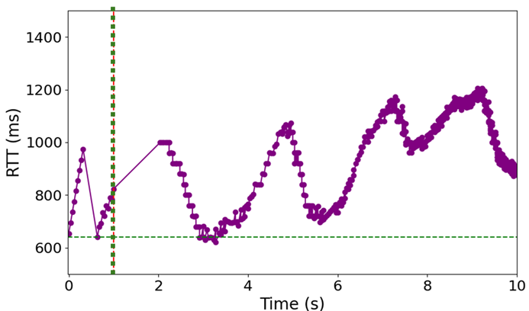
Delay-Based: HyStart++
Recognizes that delay increase a “noisy” signal
  Doesn’t have better signal!
Conservative Slow Start (CSS)
  Slower growth
  Check delay
Delay goes down?
  Yes → back to SS
  No → go to CA
CSS
CSS
CA
While in CSS grow at slower rate than 2x
If HyStart was “wrong” – grow slower for some time
If HyStart was “right” – CSS pushes past capacity limit

Slide 22
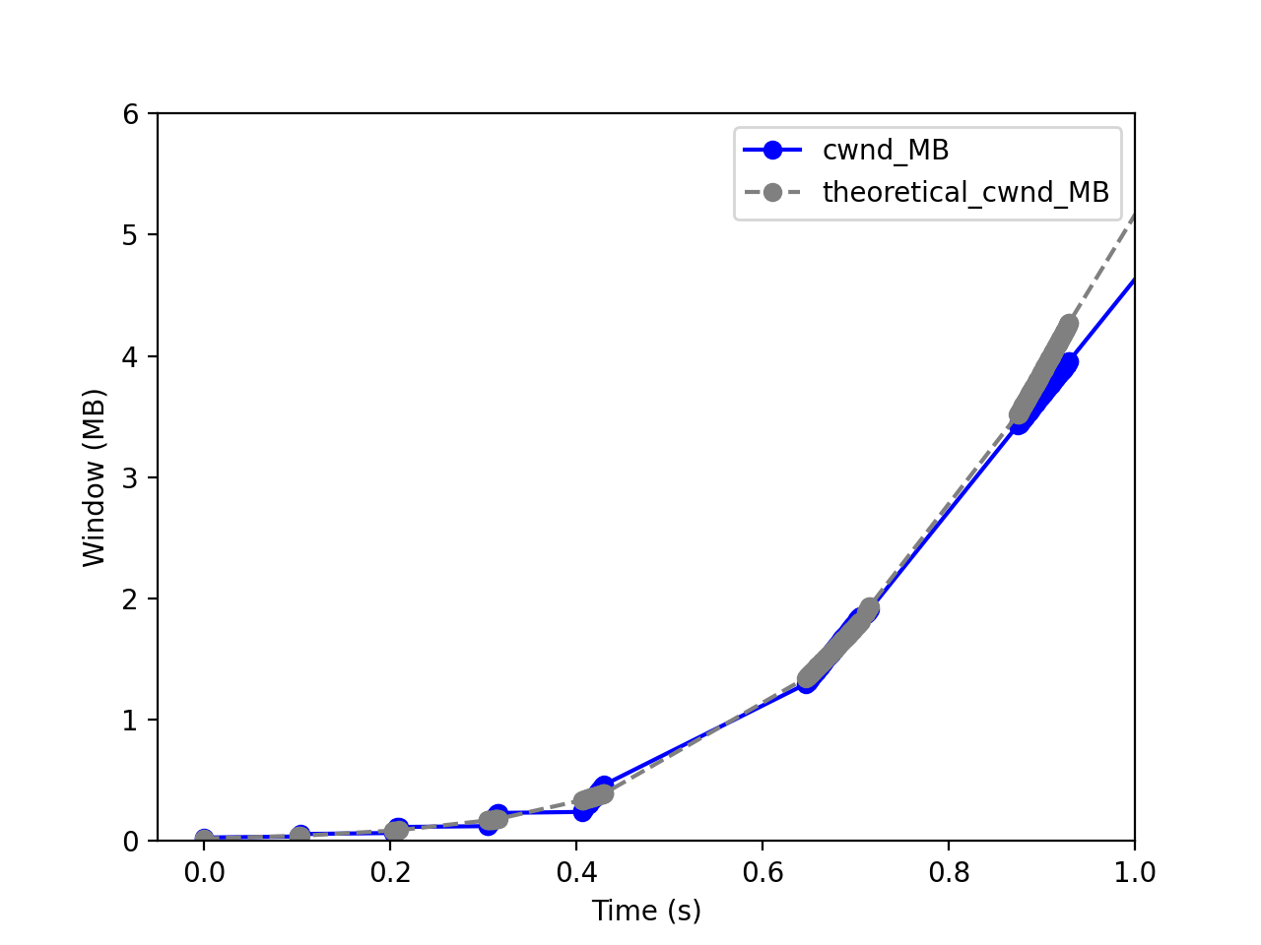
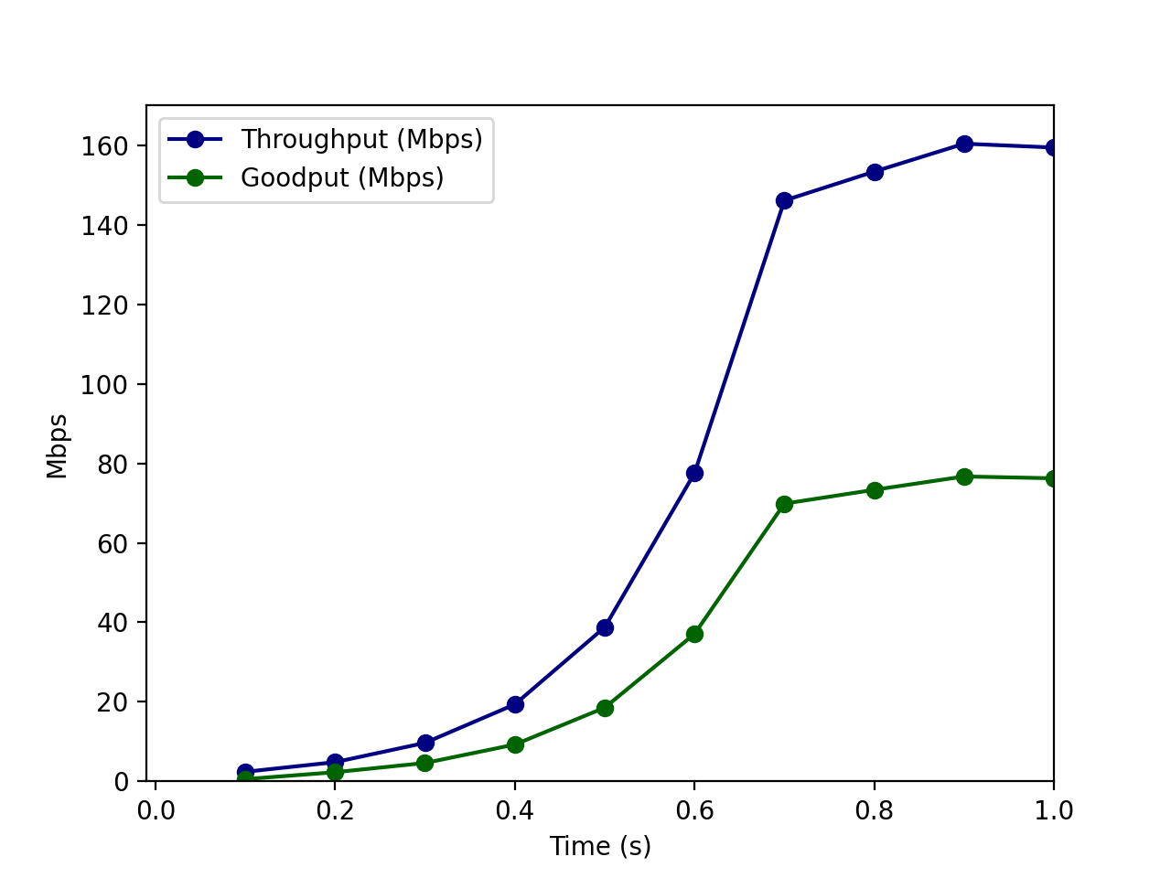
FreeBSD – Tuned
Rate: 80 Mb/s | Delay: 100 ms | Queue: 5x BDP

Slide 23
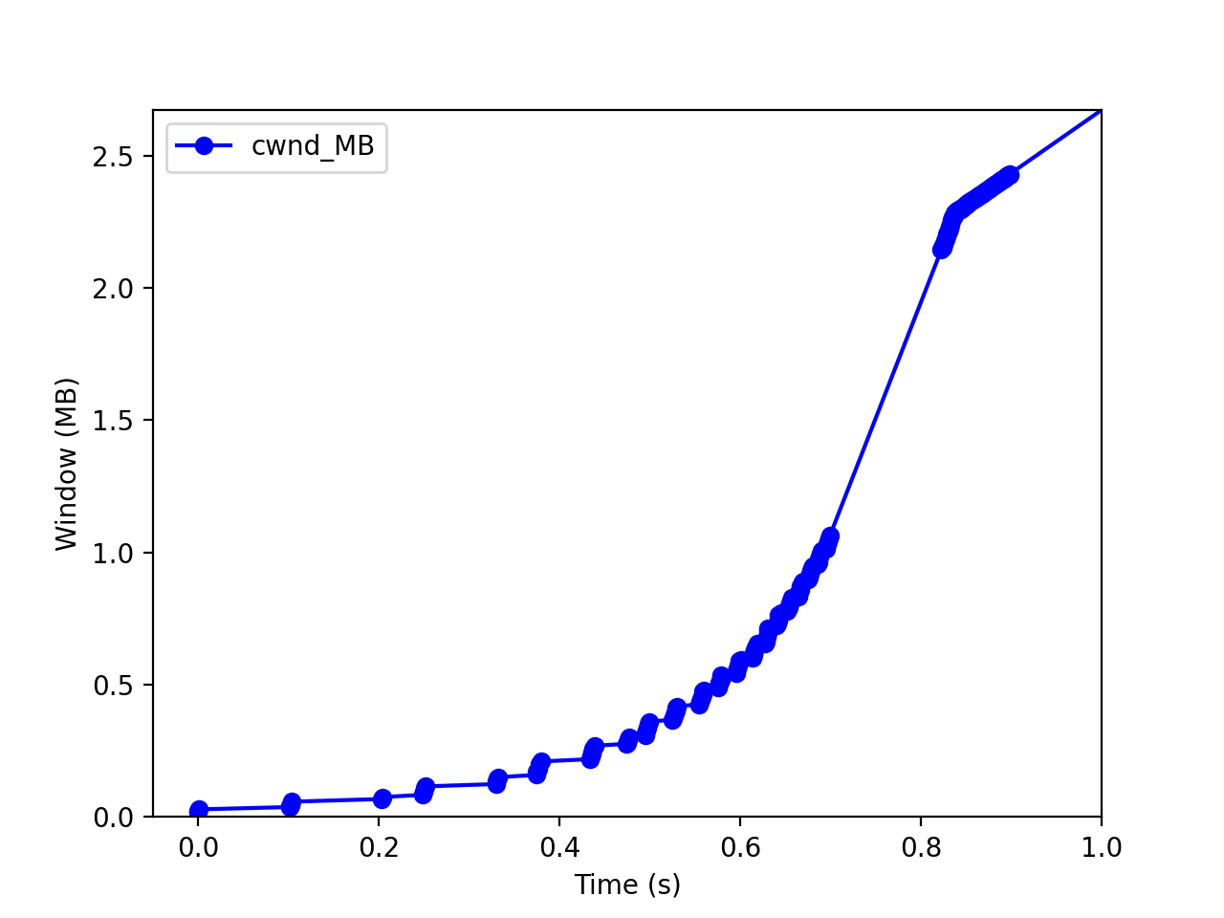
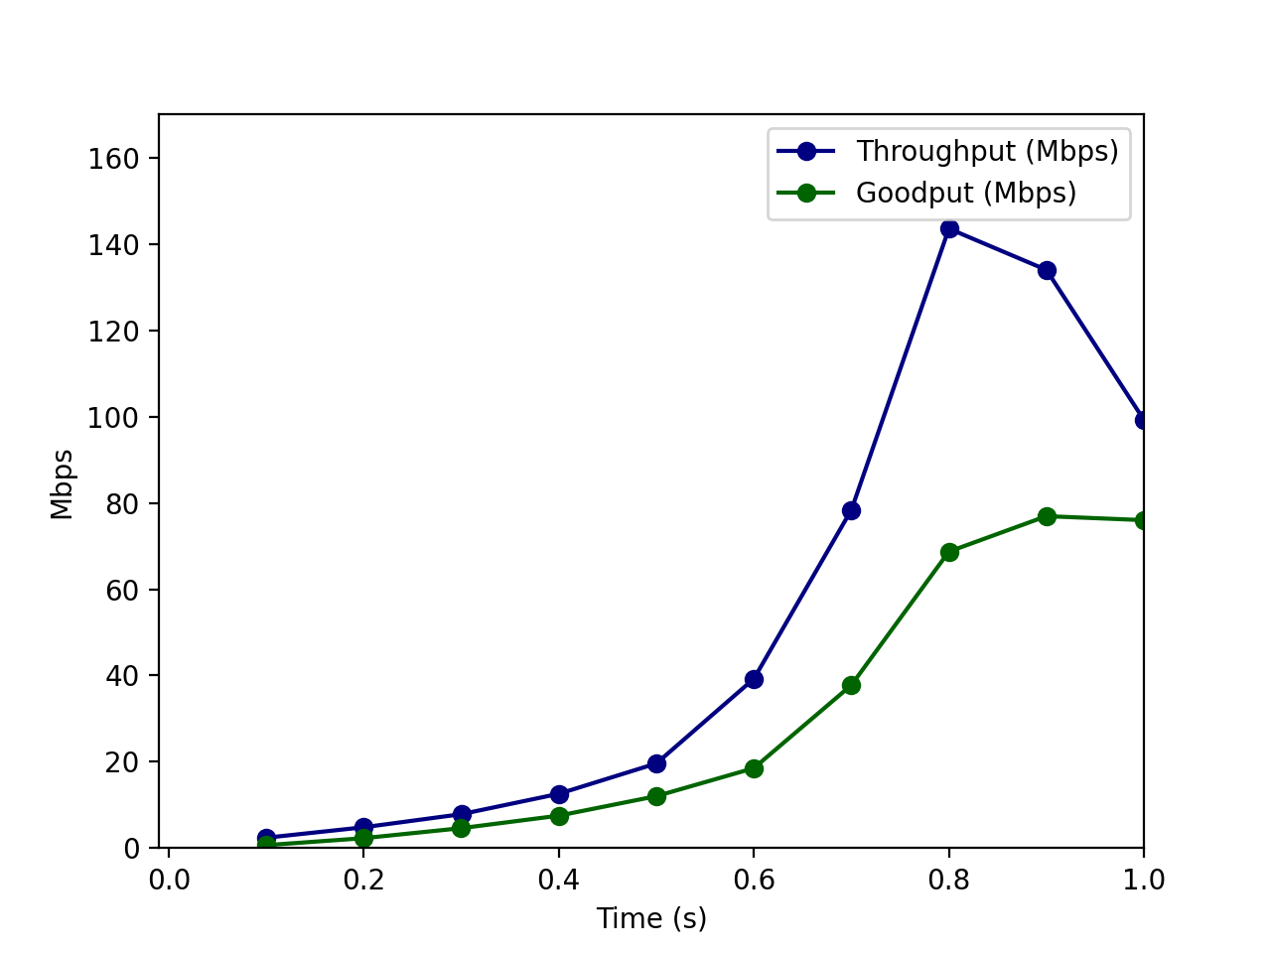
FreeBSD – Tuned, RACK – HyStart++
Rate: 80 Mb/s | Delay: 100 ms | Queue: 5x BDP

