Slide 1
SEARCH – a New Slow Start Algorithm for TCP and QUIC
UPDATE
Jae Chung
Feng Li
Maryam Ataei Kachooei
Mark Claypool
IETF CCWG
Bangkok, Thailand
March 2025

Slide 2
TCP Slow Start
Packet loss
Congestion Avoidance
Slow Start
Congestion window doubles each RTT
Packet loss Exit slow start: Too late (After loss)
Idea: Exit after reaching capacity and before loss
HyStart (Linux default)
HyStart over wireless Too early (Before capacity)
Congestion Window
Capacity
Time
Goal: At chokepoint: after capacity, before loss

Slide 3
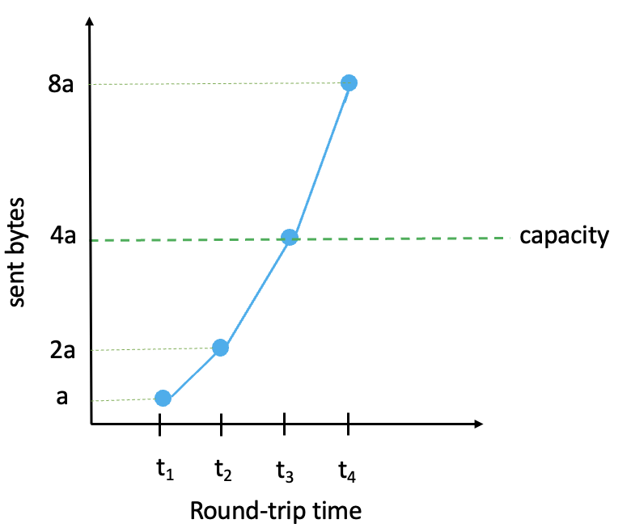
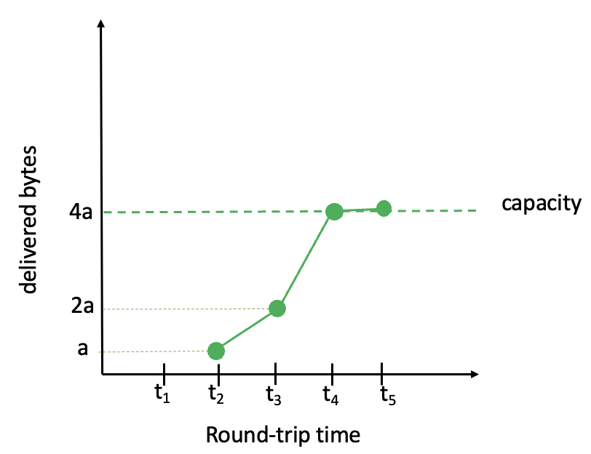
SEARCH Concept
threshold
difference
0
t₁
t₂
t₃
t₄
t₅
Round-trip time

Slide 4
SEARCH Algorithm
curr_delv
prev_delv
8a
diff = 2 prev_delv – curr delv
delivered bytes
capacity
4a
normalized diff = diff / (2 prev_delv )
2a
a
if (normalized diff $≥$ threshold):
exit from slow start
t₁
t₂
t₃
t₄
t₅
t₆
round-trip time

Slide 5
Outline
Introduction (done)
Place SEARCH in slow start space (next)
Delay-based: HyStart, HyStart++
Delivered Bytes-based: BBR, SEARCH
Memory use delivered byte history
Test framework
Summary

Slide 6
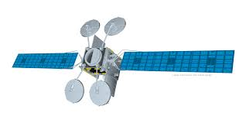
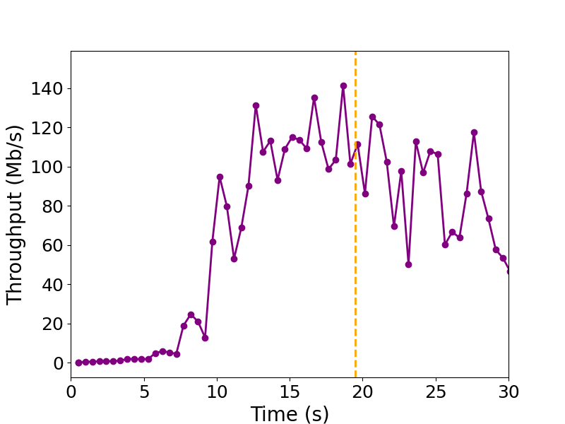
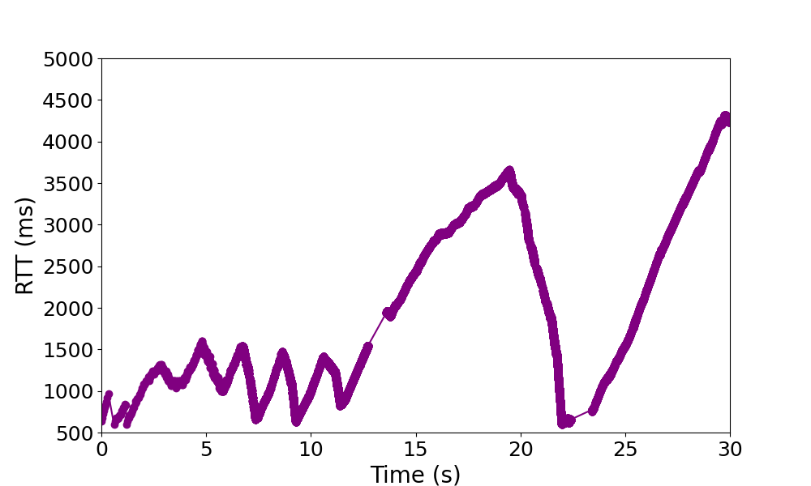
Cubic (without HyStart)

Slide 7
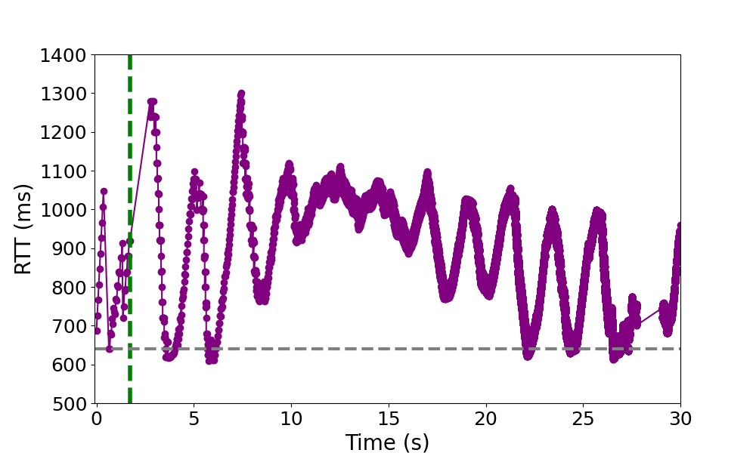
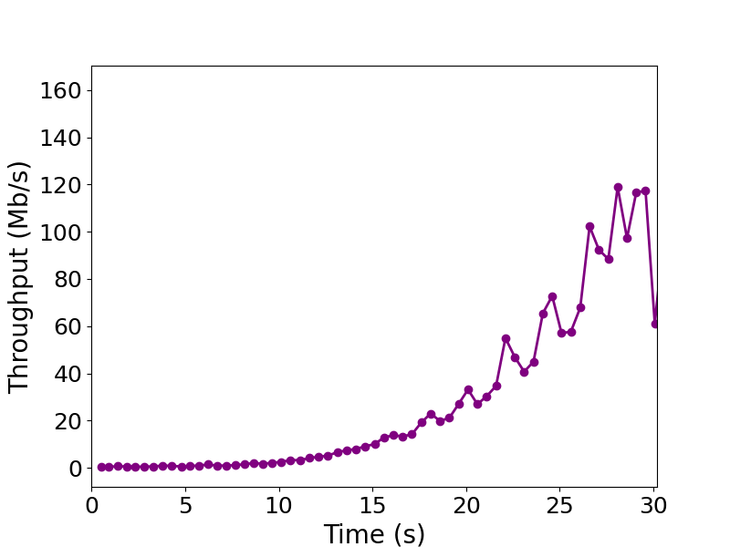
Delay-Based: HyStart
RTT “spikes” → exit SS
Sensitive to RTT variation → premature exit, underutilization
Bad in high BDP networks

Slide 8
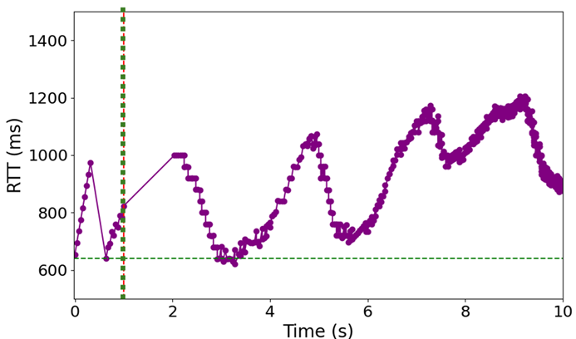
Delay-Based: HyStart++
Recognizes that delay increase a “noisy” signal
Doesn’t have better signal!
Conservative Slow Start (CSS)
Slower growth
Check delay
Delay goes down?
Yes → back to SS
No → go to CA
CSS
CSS
CA
While in CSS grow at slower rate than 2x
If HyStart was “wrong” – grow slower for some time
If HyStart was “right” – CSS pushes past capacity limit

Slide 9
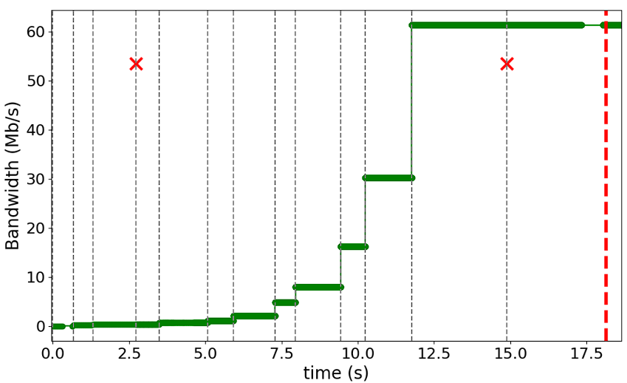
Delivered Bytes-Based: BBR
Exits when delivery rate stops growing
3 consecutive rounds (RTTs), less than 25%
Decision each round
When at capacity, RTTs increase → rounds increase

Slide 10
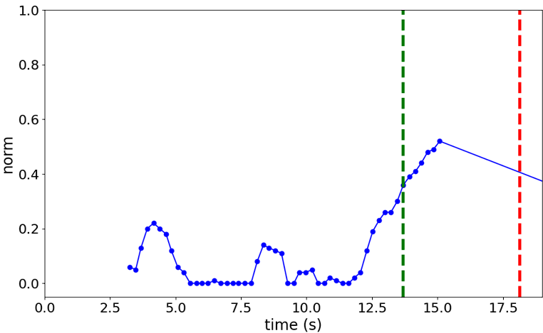
Delivered Bytes-Based: SEARCH
Exits when delivered bytes increase less than 30% from previous RTT
Decision each bin boundary (about ½ RTT)
Uses initial RTT, not current → resilient to congestion delay

Slide 11
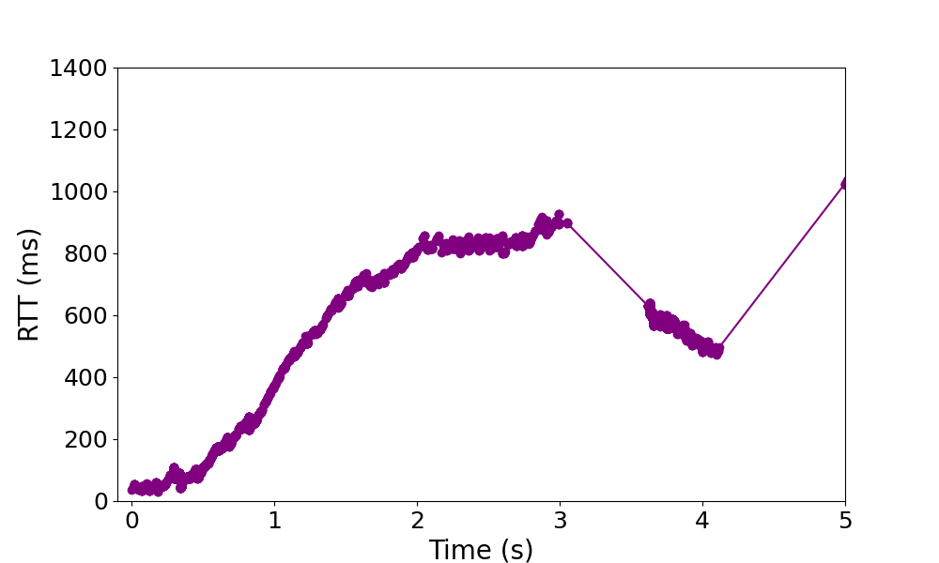
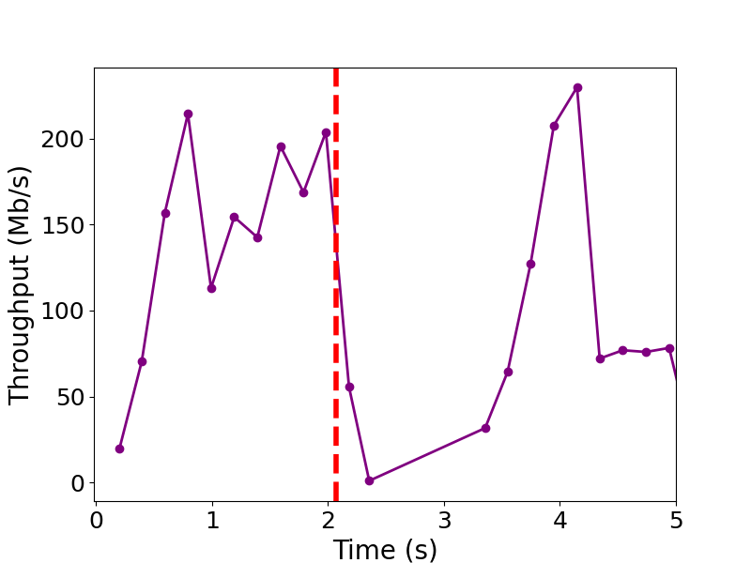
4G LTE – Same old story

Slide 12
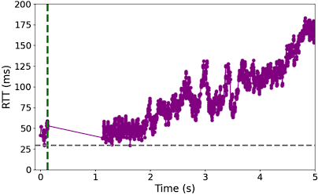
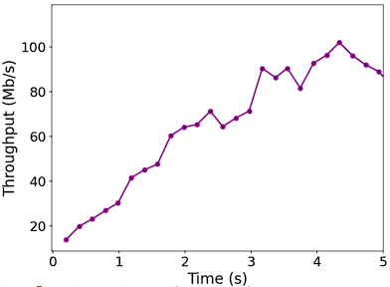
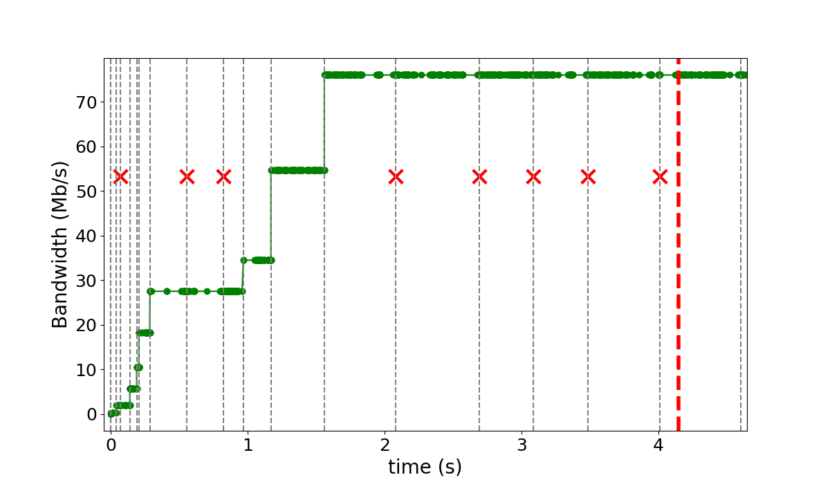
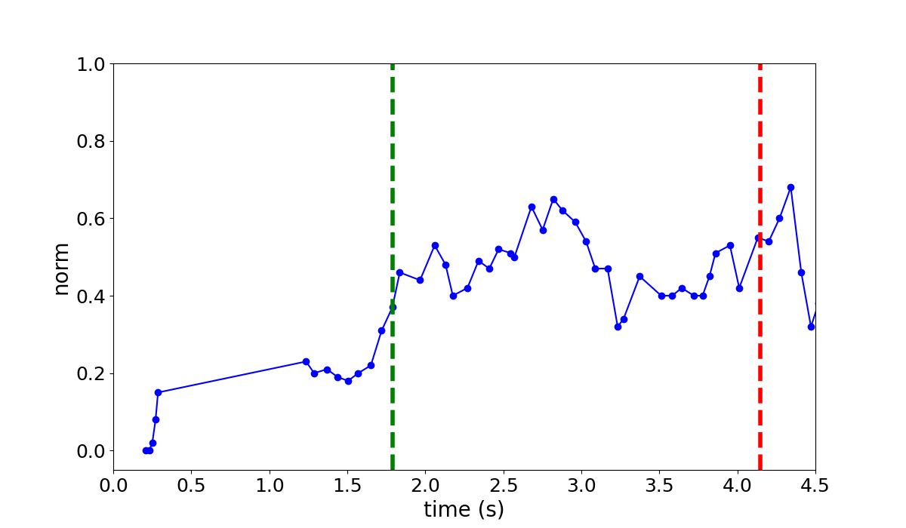
4G LTE
HyStart
HyStart
BBR
SEARCH

Slide 13
Outline
Place SEARCH in slow start space (done)
Delay-based: HyStart, HyStart++
Delivered Bytes-based: BBR, SEARCH
Memory use delivered byte history (next)
Test framework
Summary

Slide 14
Memory Use for Delivered Bytes
s₀
s₁
..
s_{N}
BBR
Time when every segment sent
When segment delivered, compute delivery rate
bytes delivered from sent to now / time
Storage overhead – time size x cwnd size
SEARCH
Sequence number each bin (~½ RTT)
When bin ends, compute delivered
seq now – seq then
Storage overhead – sequence x window
t₀
t₁
t₂
-.
t_{N}
100 Mb/s, 100 ms RTT
= 83 total
Window 10 + History 15
= 25 total

Slide 15
Outline
Place SEARCH in slow start space (done)
Delay-based: HyStart, HyStart++
Delivered Bytes-based: BBR, SEARCH
Memory use delivered byte history (done)
Test framework (next)
Summary

Slide 16
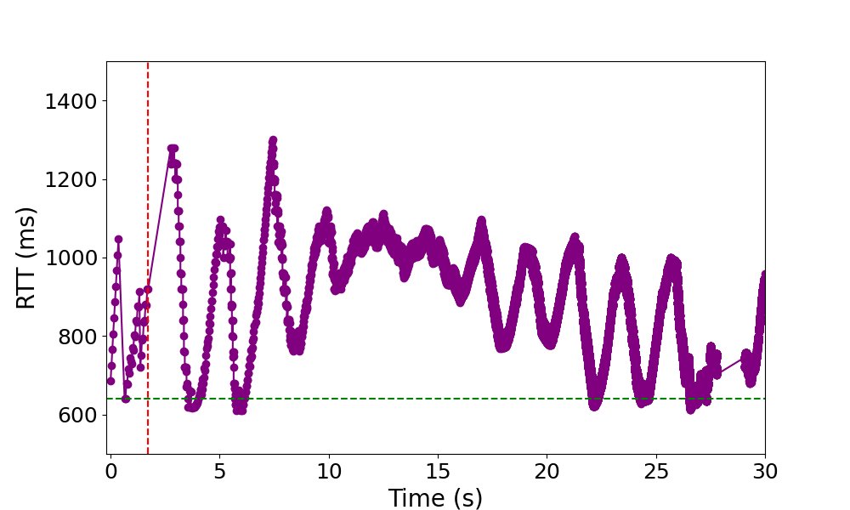
Kernel code
(tcp_cubic_search.c)
Challenges:
Verify implementations of SEARCH
Compare performance for parameter tuning
// SEARCH_defs_begin
// SEARCH_defs_end
Source Code
// SEARCH_begin
// SEARCH_end
Code Extraction
Setup Support Files
search_defs.h
search_mod.c
tcp.h
cc_helper_func.h
test_search.c
Input
CSV file
Output
Log file
t₁ s₁
t₂ s₂
…
t_{n} s_{n}
Compilation & Execution
Input csv
Output file
Pass
Pass
Fail
Pass
Server
Client

Slide 17
Using the Framework
Output
Log file
Pass
Pass
Fail
Pass
Verify and validate SEARCH implementations
Linux, versions
FreeBSD
QUIC
Compare performance
Traditional, HyStart, SEARCH
BBR, HyStart++
Traces!
Normal, edge cases
WiFi, 4g/5g, GEO, LEO, Wired

Slide 18
Summary
https://search-ss.wpi.edu/
SEARCH
Determines “choke point” from expected delivered bytes
Exits slow start after congestion point, before loss
Framework to verify implementations
Looking for volunteers to try SEARCH!
claypool@wpi.edu

Slide 19
SEARCH – a New Slow Start Algorithm for TCP and QUIC
Thank-you for your attention!
Jae Chung
Feng Li
Maryam Ataei Kachooei
Mark Claypool
IETF CCWG
Bangkok, Thailand
March 2025

Slide 20
References
Improving TCP Slow Start Performance in Wireless Networks with SEARCH
IEEE World of Wireless, Mobile and Multimedia Networks (WoWMoM)
Perth, Australia, June 2024
Improving QUIC Slow Start Behavior in Wireless Networks with SEARCH
IEEE Local and Metropolitan Area Networks (LANMAN)
Boston, Massachusetts, USA, July 2024
Implementation of the SEARCH Slow Start Algorithm in the Linux Kernel
0x18 NetDev Conference
Santa Clara, California, USA, July 2024
Reducing Per-flow Memory Use in TCP SEARCH
IEEE World of Wireless, Mobile and Multimedia Networks (WoWMoM)
Fort Worth, TX, USA, May 2025

Slide 21
TCP Congestion Control Test Framework
ss_extract.py - Extracts Relevant Code
Usage: ss_extract.py -f original_file.c -k keyword
Functionality:
Extracts slow start-related code using labeled sections (keyword_begin, keyword_end, keyword_defs.begin, keyword_defs.end).
Generates three key files in test_dir:
keyword_modules.c
keyword_defs.h
tcp.h (based on extracted modules)

Slide 22
TCP Congestion Control Test Framework
2. ss_setup.py - Sets Up Testing Environment
Usage: ss_setup.py -k keyword
Functionality:
Determines the appropriate test file for the specified protocol.
If a predefined test_keyword.c exists for the keyword (e.g., SEARCH, HyStart, BBR), it is placed in test_dir.
If no predefined test file is available, test_base.c is provided for user modification.
Places cc_helper_functions.h, which includes essential congestion control functions, in test_dir. Users can extend this file by extracting additional functions from the kernel if needed.

Slide 23
TCP Congestion Control Test Framework
3. ss_run.py - Executes the Tests
Usage: ss_run.py -k keyword -i input -o output
Functionality:
Runs the test with specified input CSV files.
Runs test_keyword:
Reads the input CSV file with test parameters.
Applies the congestion control logic.
Outputs test results to output.txt.

Slide 24
Per-Flow Memory Use
Cubic
Cubic + HyStart
Cubic + SEARCH (u8)
BBR
Cubic + SEARCH (u16)
Cubic + SEARCH (u32)

