Slide 1


SEARCH – a New Slow Start Algorithm for TCP and QUIC
Jae Chung
Feng Li
Maryam Ataei Kachooei
Mark Claypool
IETF CCWG
Vancouver, Canada
July 2024

Slide 2
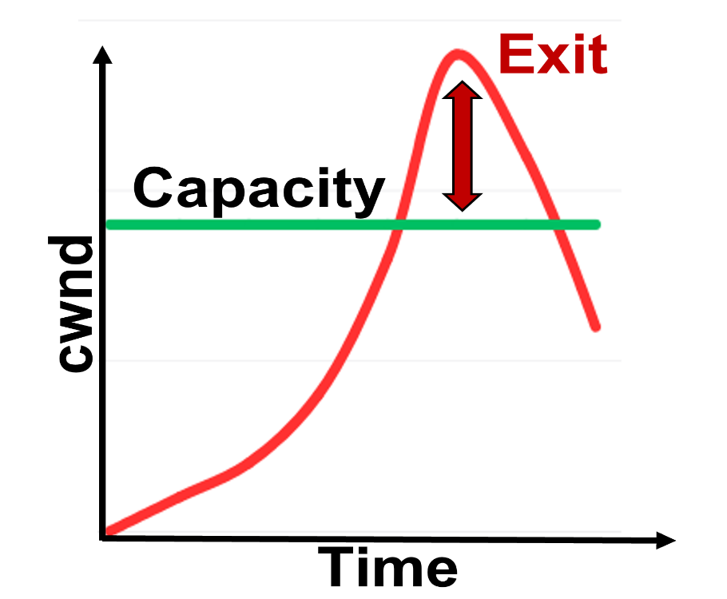
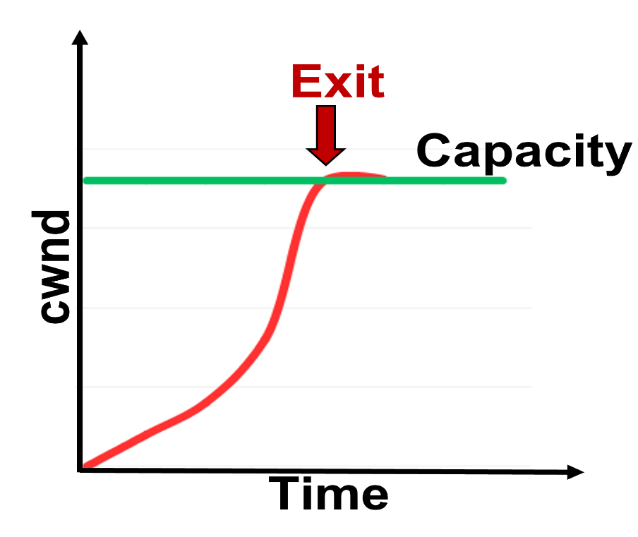
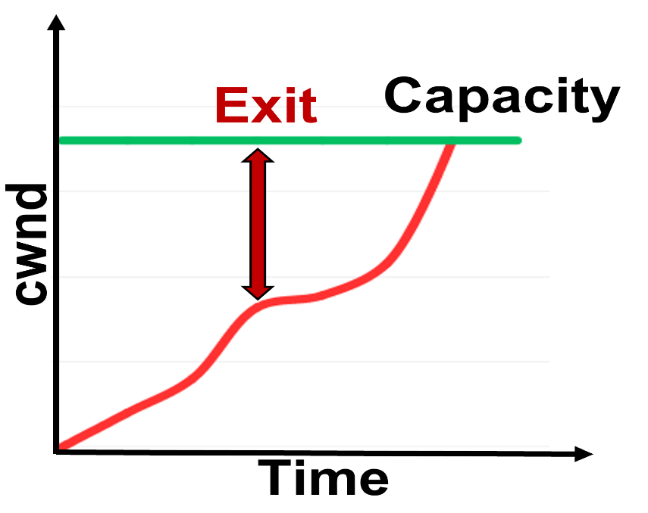

Motivation
TCP HyStart over Wireless?
Exit Too Early
Exit Too Late
Exit at Choke Point

Slide 3

on
off
on
off
GEO
cwnd
cwnd
4G LTE
capacity
capacity
1.3
11.8
22.9
0.1
0.3
1.9
time (s)
time (s)
on
off
on
off
LEO
cwnd
cwnd
Wi-Fi
capacity
capacity
0.1
0.4
0.6
0.02
0.03
0.19
time (s)
time (s)

Slide 4
Outline
Motivation (done)
SEARCH (next)
Performance Evaluation
Conclusion

Slide 5
SEARCH – Slow start Exit at Right CHokepoint
8a
8a
sent bytes
delivered bytes
4a
capacity
4a
capacity
2a
2a
a
a
t₁
t₂
t₃
t₄
t₅
t₁
t₂
t₃
t₄
Time
Time

Slide 6
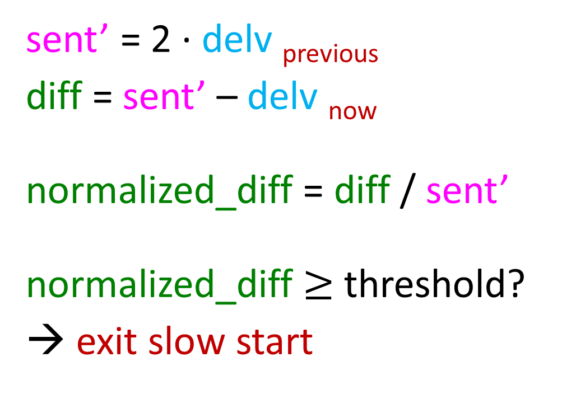
SEARCH – Slow start Exit at Right CHokepoint
sent’ = 2 ∙ delv _{previous}
diff = sent’ – delv _{now}
normalized_diff = diff / sent’
normalized_diff $≥$ threshold?
→ exit slow start
8a
delivered bytes
4a
capacity
2a
a
t₁
t₂
t₃
t₄
t₅
Time

Slide 7
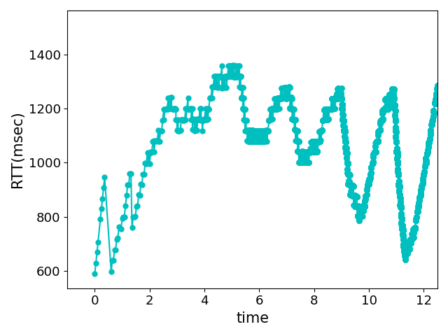
Challenges
RTT
Variable RTTs
Not caused by congestion on forward link
Caused by uplink ACK schedule timing
Limit memory on server
Memory allocated per flow
Can’t store history for each ACK
window
Bin
Bin
Bin

Slide 8
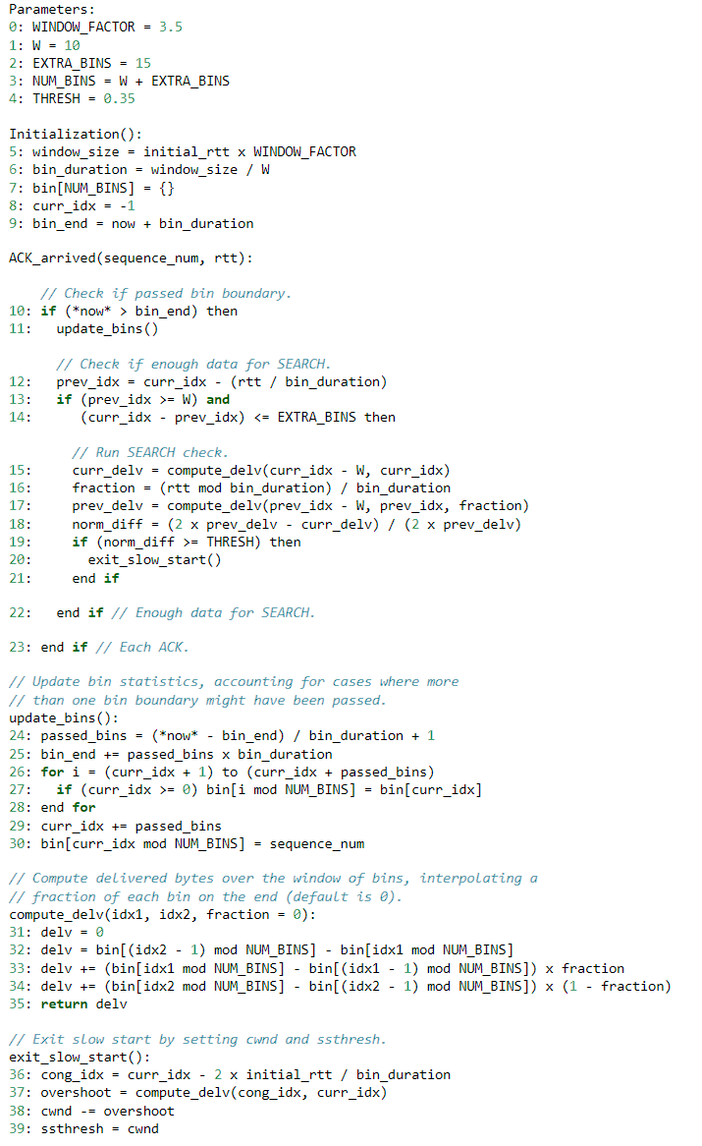





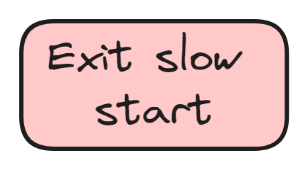
SEARCH

Slide 9
Parameter Selection
Improving TCP Slow Start Performance in Wireless Networks with SEARCH
IEEE World of Wireless, Mobile and Multimedia Networks (WoWMoM)
Perth, Australia, June 2024.
Window
Window size:
  Large enough for link RTT variation
  Small enough to respond quickly
Number of bins:
  Large enough to reduce load
  Small enough to maintain fidelity and respond quicky
Threshold:
  Large enough so above noise
  Small enough to respond quickly
?
0: WINDOW_FACTOR = 3.5
1: W = 10
2: EXTRA_BINS = 15
3: NUM_BINS = W + EXTRA_BINS
4: THRESHOLD = 0.35
Bin
Bin
Bin
Bin
Bin
Bin
Bin
Bin
Bin
Bin
Bin
Bin
Bin
?
?
RTT
?

Slide 10
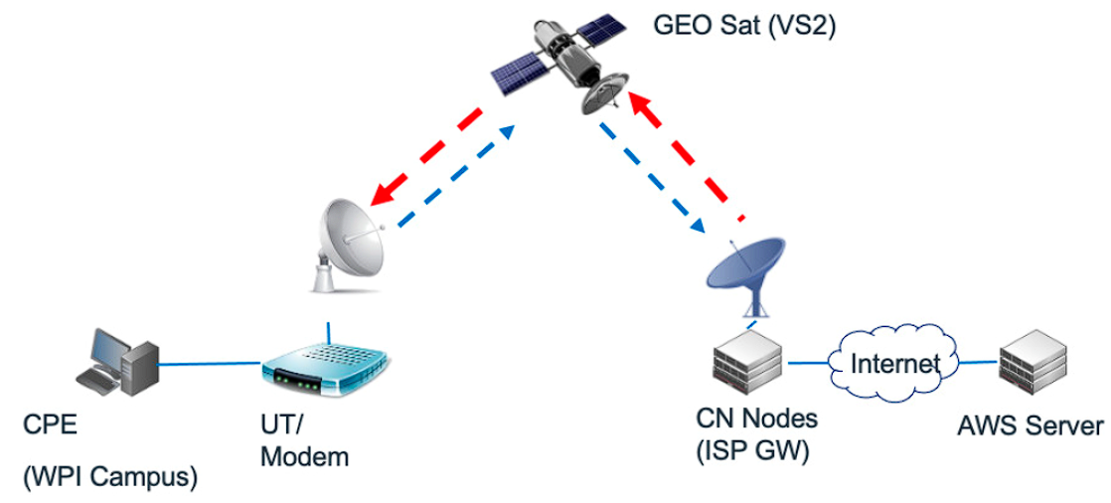
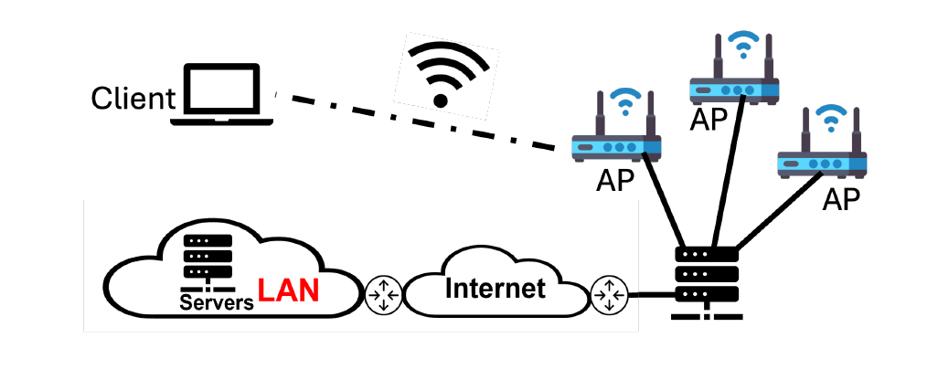
Outline
Motivation (done)
SEARCH (done)
Performance Evaluation (next)
Conclusion
GEO
Wi-Fi

Slide 11
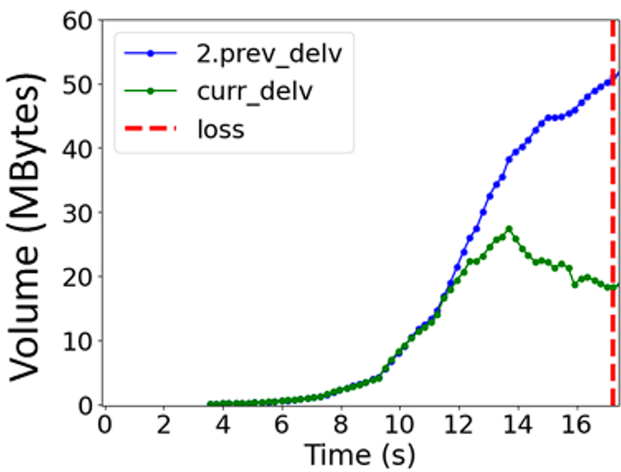
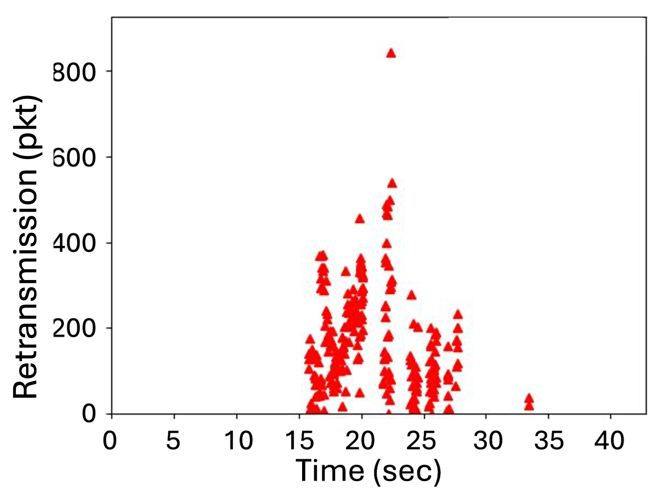
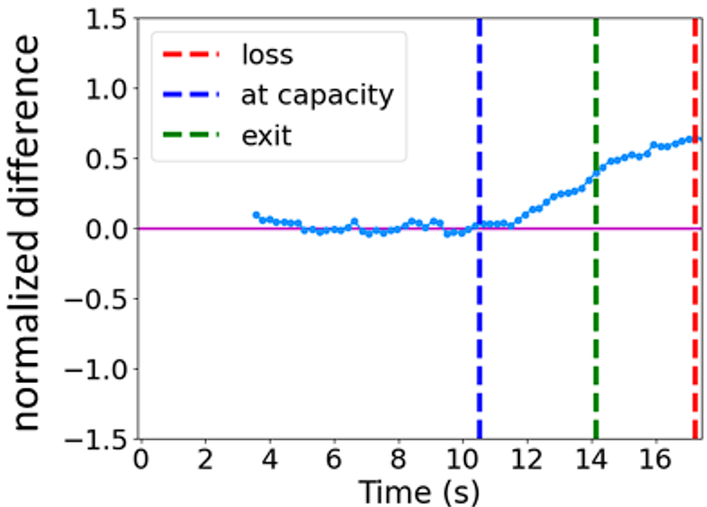
Performance –
GEO Satellite
HyStart On
HyStart Off
SEARCH

Slide 12
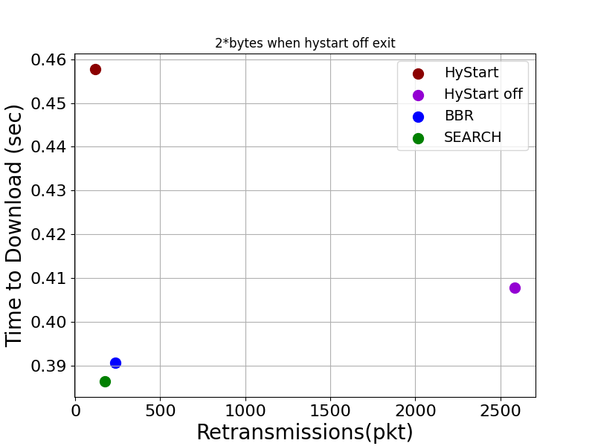
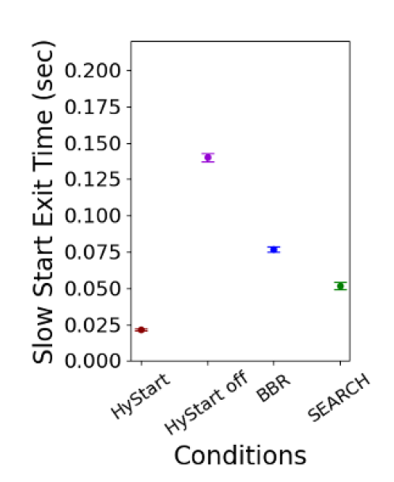

Performance – Wi-Fi
~15 MBytes

Slide 13
Implementation Status
Linux Kernel Modules
  5.13.x series kernel (main branch)
  https://github.com/Project-Faster/tcp_ss_search.git
  6.10rc2 based (net-next-6.10rc2 branch)
  https://github.com/Project-Faster/tcp_ss_search/tree/net-next-6.10rc2
QUIC H2O/Quicly
  https://github.com/Project-Faster/quicly/tree/generic-slowstart
Upstream into Linux mainstream and open source QUIC

Slide 14

Conclusion
HyStart does not work in wireless environments (GEO, LEO, 4G LTE, Wi-Fi) → premature slow start exits
SEARCH
  Determines “choke point” from expected delivered bytes
  Exits slow start after congestion point, before loss
  Improves utilization, reduces packet loss (versus off)
https://search-ss.wpi.edu/

Slide 15
SEARCH – a New Slow Start Algorithm for TCP and QUIC
Thank-you for your attention!
Jae Chung
Feng Li
Maryam Ataei Kachooei
Mark Claypool
IETF CCWG
Vancouver, Canada
July 2024

Slide 16
References
Improving TCP Slow Start Performance in Wireless Networks with SEARCH
  IEEE World of Wireless, Mobile and Multimedia Networks (WoWMoM)
  Perth, Australia, June 2024.
Improving QUIC Slow Start Behavior in Wireless Networks with SEARCH
  IEEE Local and Metropolitan Area Networks (LANMAN)
  Boston, Massachusetts, USA, July 2024
Implementation of the SEARCH Slow Start Algorithm in the Linux Kernel
  0x18 NetDev Conference
  Santa Clara, California, USA, July 2024

Slide 17
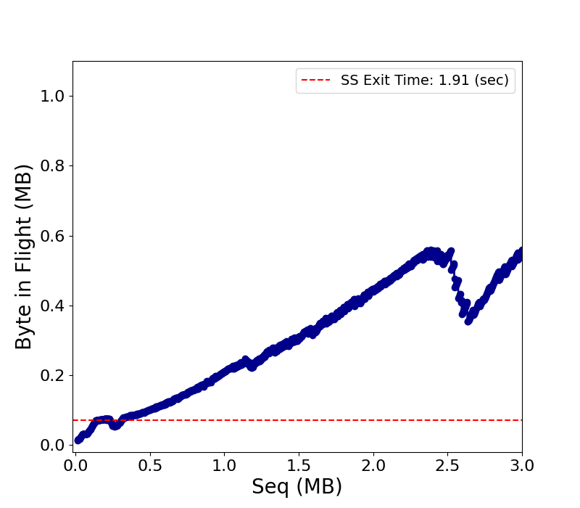
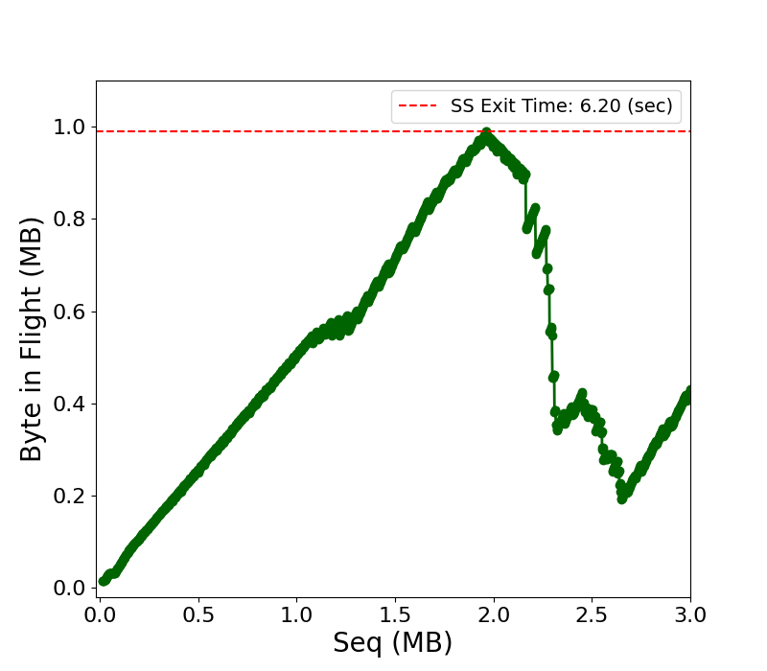
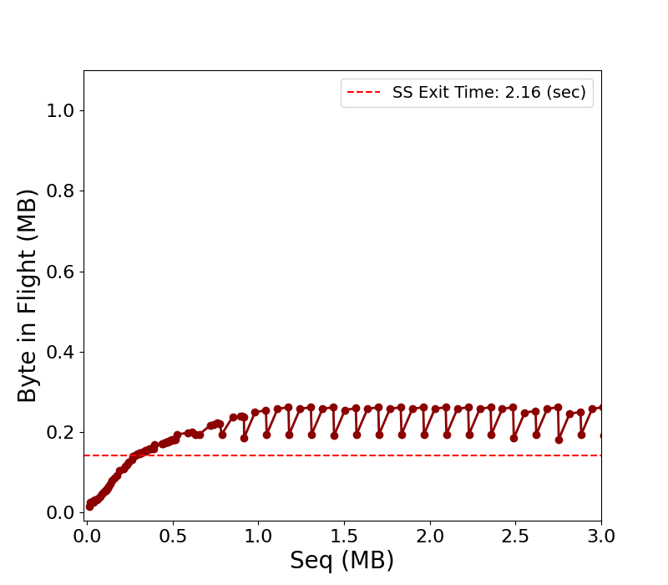
HyStart On, HyStart Off, HyStart++
1.1s Hystart On
2.1s Hystart++
6.5s HyStart Off
HyStart On
HyStart Off
HyStart++
“Troubleshooting Enhancement with Automated Slow-Start Detection”

