Slide 1


SEARCH – a New Slow Start Algorithm for TCP and QUIC
UPDATE
Jae Chung
Feng Li
Maryam Ataei Kachooei
Mark Claypool
IETF 126 CCWG
Vienna, Austria
July 2026

Slide 2

Outline
TCP slow start exit signal
TCP SEARCH drain upon exit
Ongoing work
Notes:
In response to Mirja Kühlewind’s question on RTT vs Delivery rate signal comparison.

Slide 3
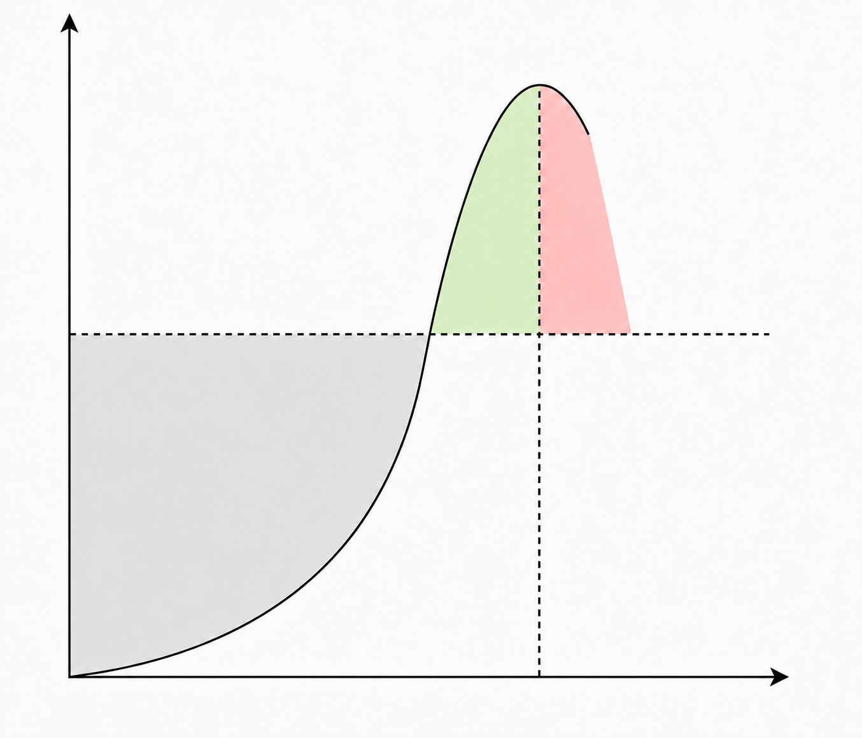
TCP Slow start exit
Loss
Loss / ECN
Traditional TCP
cwnd
BDP
Signals
RTT Inflation
HyStart/ HyStart++
Time
Delivery Rate
BBR/SEARCH
Too early:
Leaves capacity unused
Right time:
Near BDP, good utilization with limited queue
how clear is the signal near the available bandwidth?
Too late:
Loss, retransmission

Slide 4
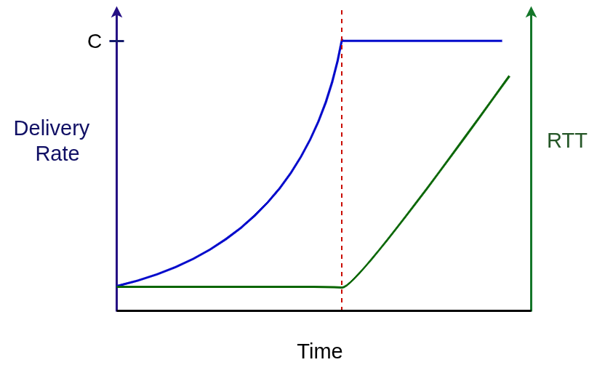
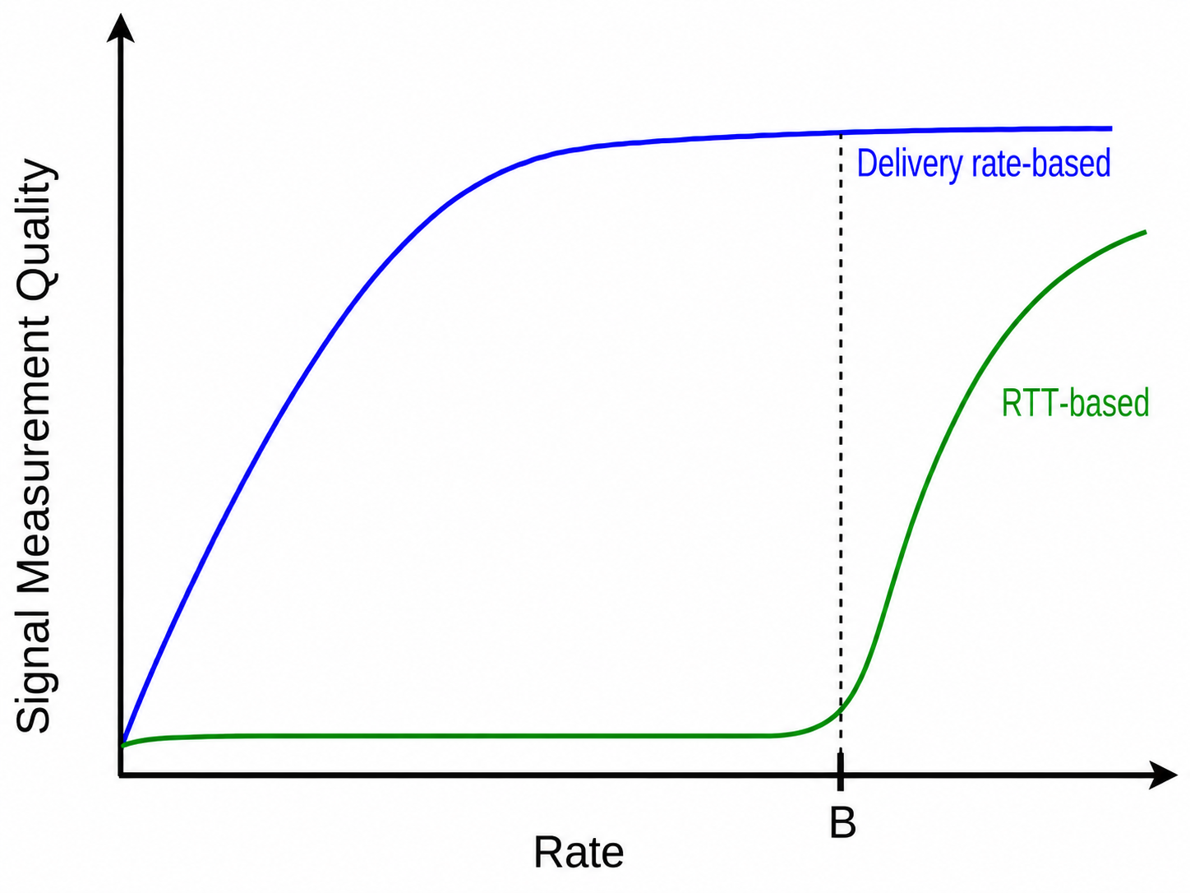
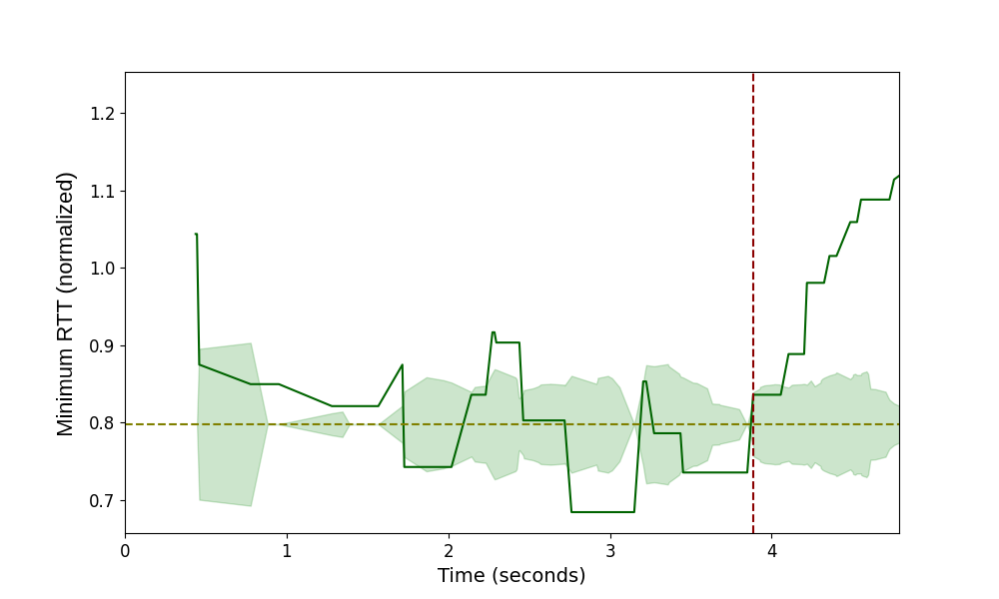
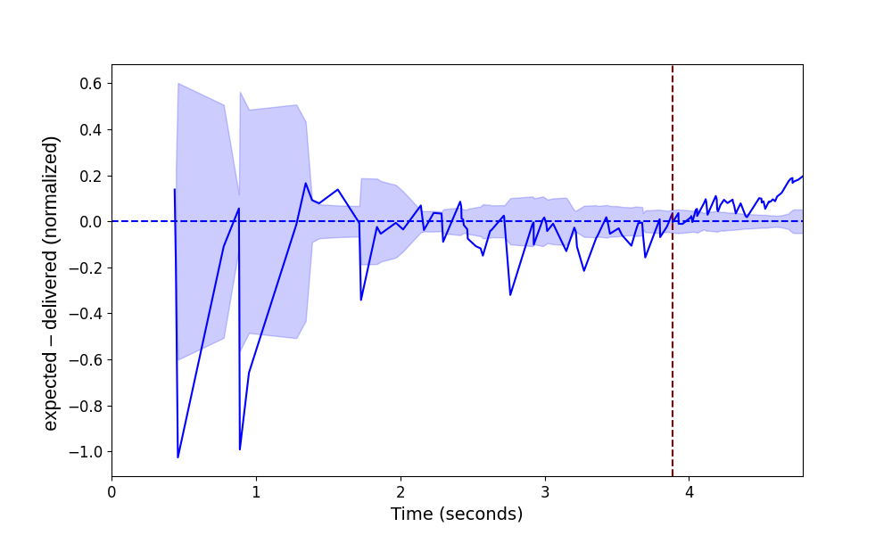
Round trip time versus delivery rate as exit signal
B
Minimum RTT
Normalized Diff
(sent_{rtt_ago} – delv) / sent_{rtt_ago}
Shaded region: rolling standard deviation over a 1-initial RTT window

Slide 5
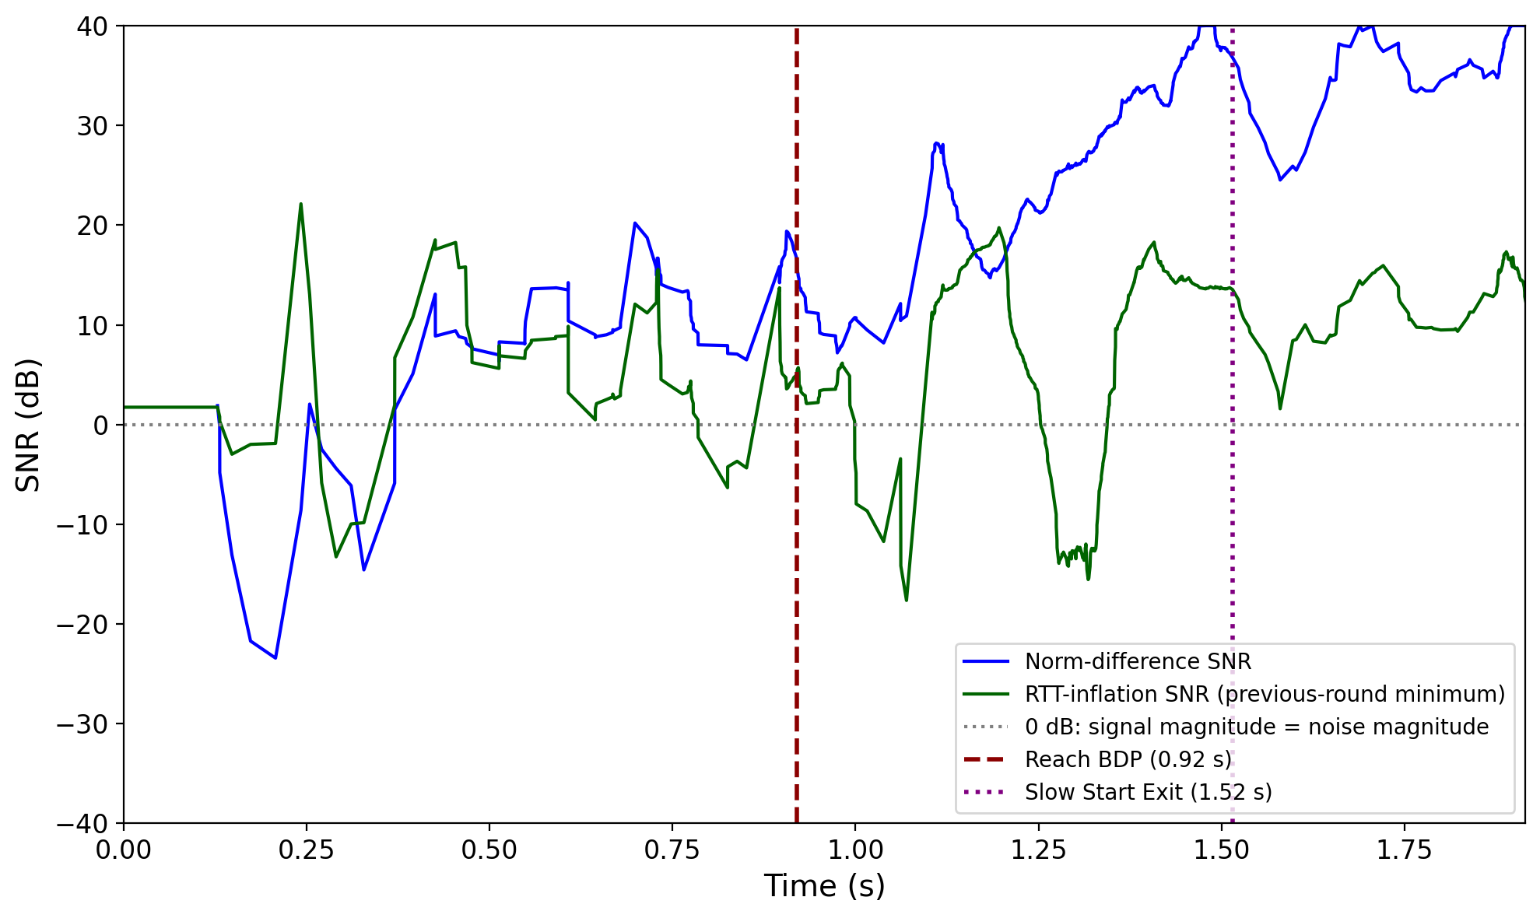
SNR(RTT-inflation) versus SNR(Norm-diff)
SNR( RTT-inflation )
@ BDP
Norm-diff SNR gets stronger near and after BDP
RTT-inflation SNR is weak near BDP when using min RTT of the last round as the base RTT
SNR( Norm-diff )
@ SS Exit
SNR(X) = 20 log₁₀ (last_round_avg(X) / last_round_std(X))
Norm-diff = (sent_{rtt_ago} – delivered) / sent_{rtt_ago}
RTT-inflation = RTT – RTT_{last_round_min}

Slide 6
Outline
TCP slow start exit signal
TCP SEARCH drain upon exit
Ongoing work

Slide 7
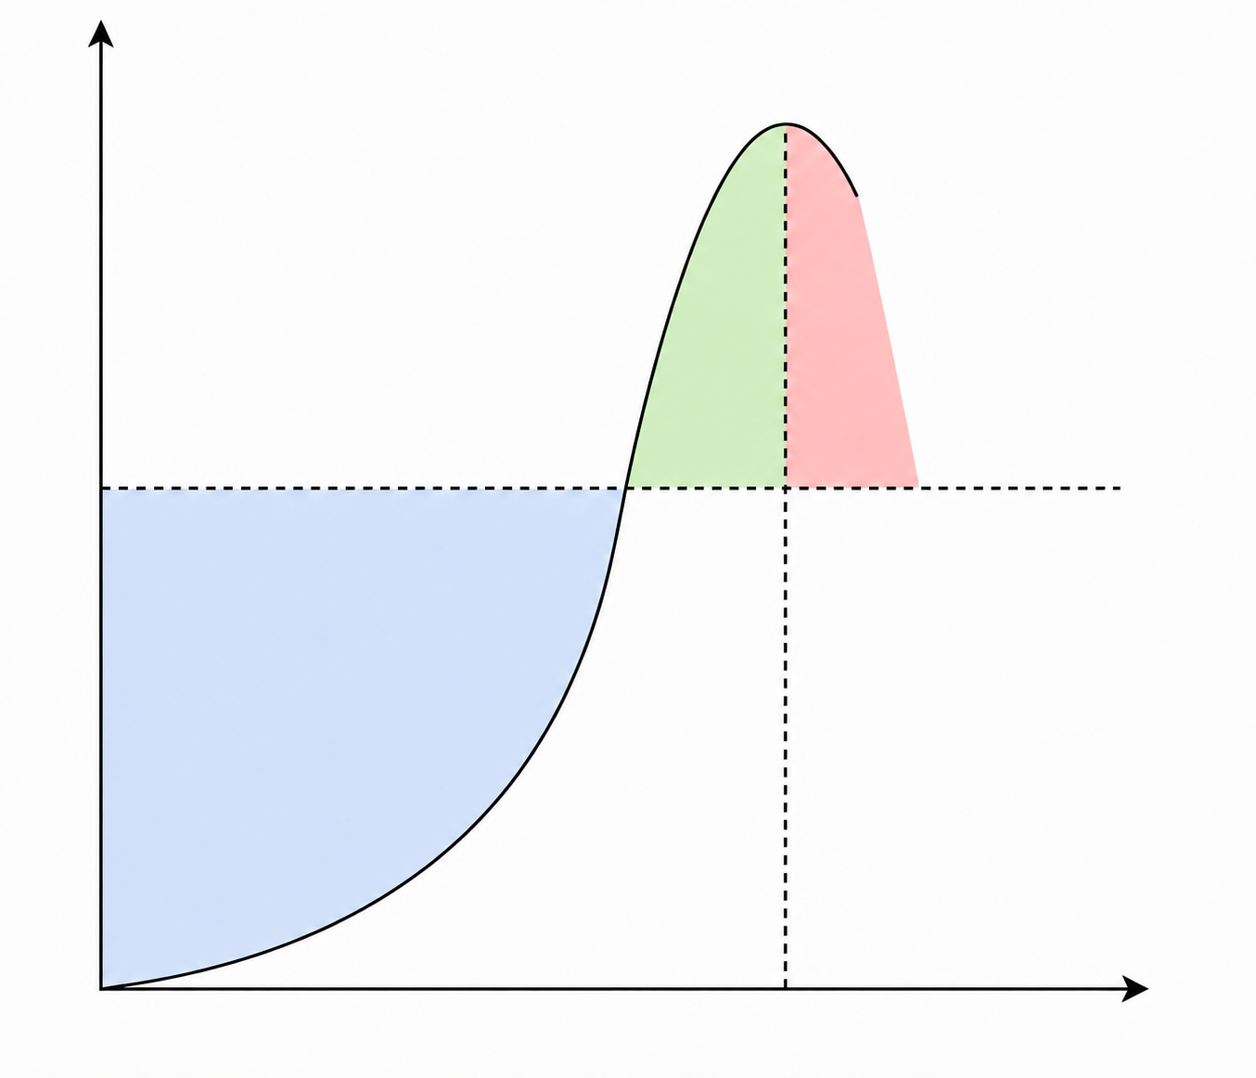
TCP SEARCH Drain upon Exit
SEARCH threshold crossed
Slow start ramp
SEARCH exit
Drain
toward BDP
SEARCH detects
available bandwidth
compute target_cwnd
cwnd
BDP
Earlier version:
Exit slow start
ssthresh = cwnd
NEW: Drain
reduce excess inflight
drain excess in-flight data
Time
enter congestion avoidance
target cwnd ≈ delivered bytes over the last RTT (delivery bytes over the last 3 bins in SEARCH)
cwnd = max(inflight – Δ, target_cwnd)
Notes:
cwnd_target prevents the window from draining below the estimated BDP.
inflight + Δ allows limited forward progress during drain.
Δ grows slowly: E.g., +1 packet for every 3 ACKs.
Drain ends when cwnd reaches the target and enter congestion avoidance phase.

Slide 8
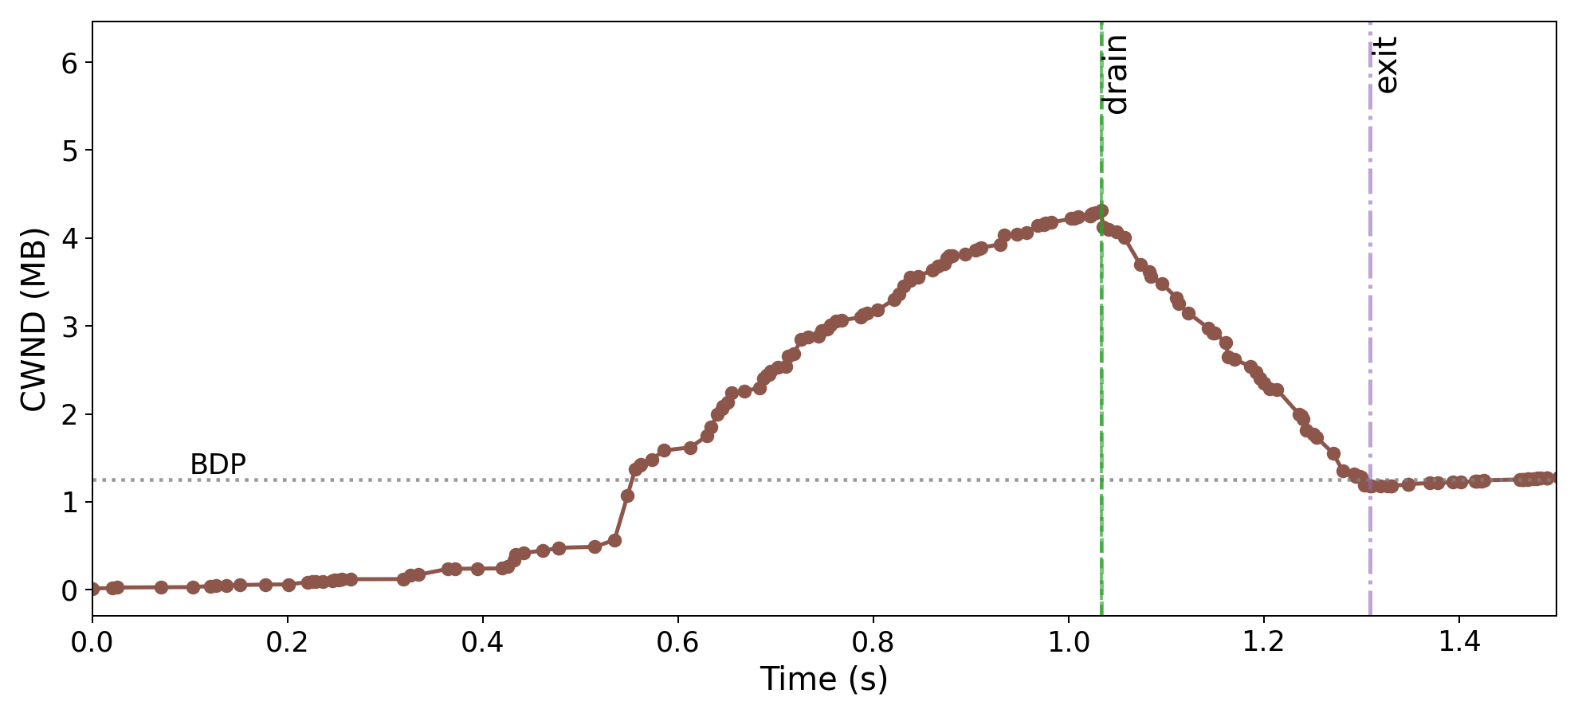
TCP SEARCH Drain Example
Controlled dataset: Rate 100Mb/s, RTT 100ms, queue 4x BDP, jitter 26ms

Slide 9
Outline
TCP slow start exit signal
TCP SEARCH drain upon exit
Ongoing work

Slide 10
Ongoing Works: Adaptive CWND Growth Rate on SNR

Slide 11
Summary
Signals for slow start exit:
  RTT Inflation (from RTT_{last_round_min}): Noisy on wireless/cellular/satellite paths
  Delivery Rate (normalized by sent rate): Clearer near available bandwidth
SEARCH with Drain:
  Enter congestion avoidance with a full pipe, not an overfull queue
Ongoing work:
  Adaptive CWND growth rate

Slide 12
SEARCH – a New Slow Start Algorithm for TCP and QUIC
Thank-you for your attention!
Jae Chung
Feng Li
Maryam Ataei Kachooei
Mark Claypool
IETF 126 CCWG
Vienna, Austria
July 2026

